Slide 1
CONTENT MANAGEMENT SYSTEM
Presented by:
Mukesh A. Pund
Principal Scientist
CSIR-NISCAIR, New Delhi

Slide 2
JOOMLA WEBSITE BACKUP & SEO
EMBED GOOGLE MAPS

Slide 3
PLUGIN
A plugin is a kind of Joomla! extension. Plugins provide functions which are associated with trigger events. Joomla provides a set of core plugin events, but any extension can fire (custom) events. When a particular event occurs, all plugin functions of the type associated with the event are executed in sequence. This is a powerful way of extending the functionality of the Joomla! Platform. It also offers extension developers a way to allow other extensions to respond to their actions, making extensions extensible.
The Joomla! plugin architecture follows the Observer design pattern. The JPlugin class provides the means to register custom plugin code with core or custom events. The JDispatcher class (JEventDispatcher in Joomla 3.x) is an event handler which calls all plugins registered for a particular event, when that event is triggered.

Slide 4
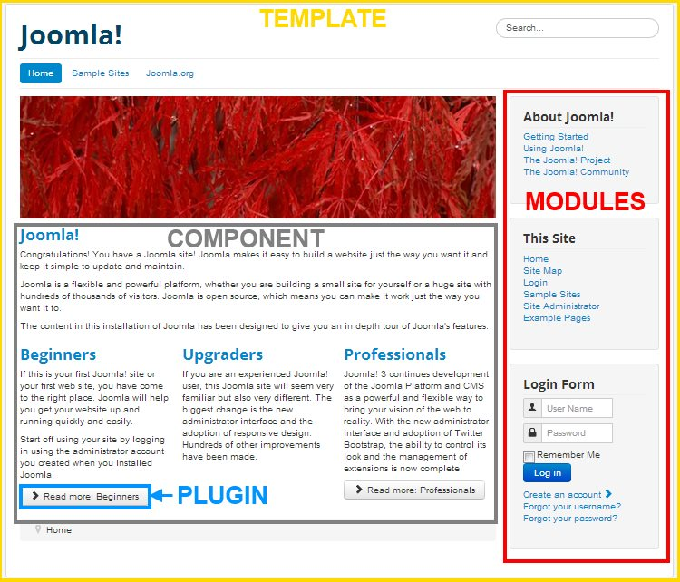

Slide 5
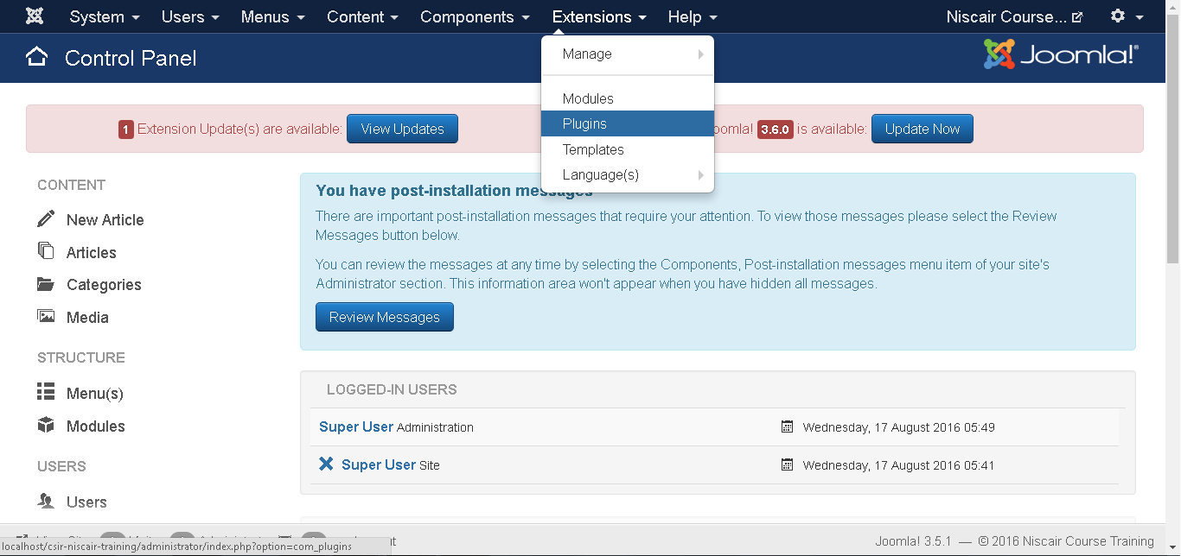
Step (1): Click on Extension --> Plugin in Joomla administrator as shown below.

Slide 6
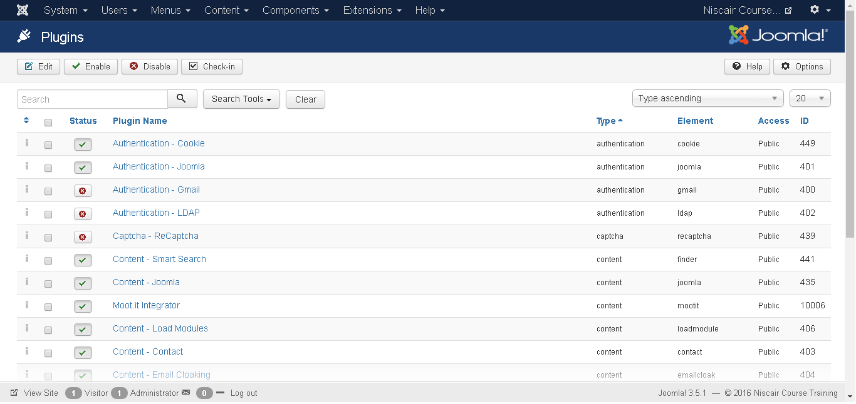
Step (2): After clicking on the Plugin , an existing Joomla plugin will be
displayed as shown below.
Toolbar
Following are the toolbar options in the Plugin:
Edit: Edit the plug-in.
Enable: Enable the plug-in to use on the website.
Disable: Disable the plug-in which are not necessary on the website.
Check In: Used to check in the plug-in and after completing the process displays the successful message.

Slide 7
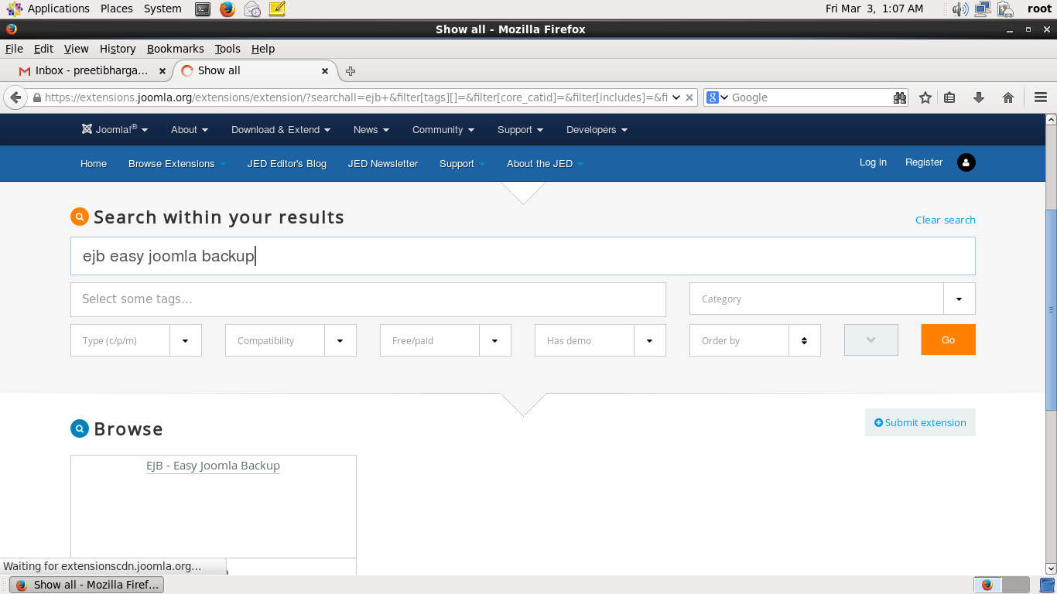
WEBSITE BACKUP
Step (1): To take website backup you have to download and Install EJB(Easy Joomla Backup) Plugin from https://extensions.joomla.org

Slide 8
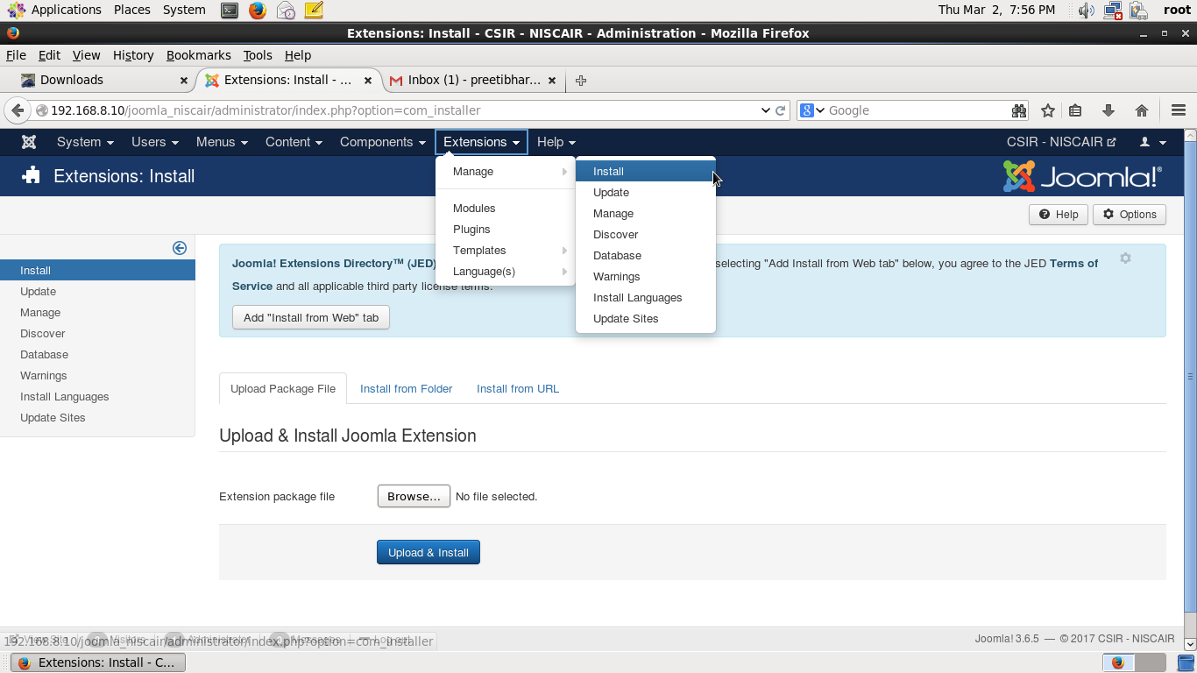
Step (2): Go to Extensions → Manage → Install

Slide 9
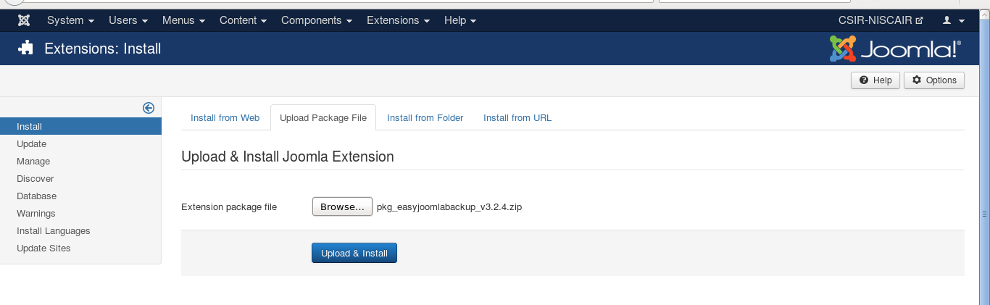
Step (3): Click on “Upload Package File” and browse for the downloaded package. Click on “Upload and Install”

Slide 10
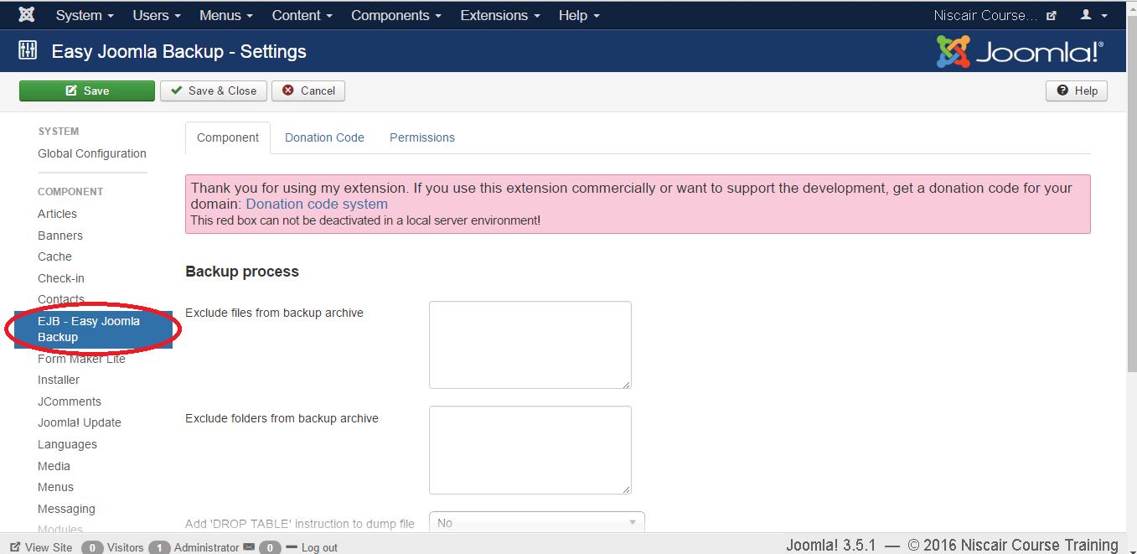
Step (4): Click on System --> Global Configuration in Joomla administrator. You will get the following screen.

Slide 11
Step (5): Next, click on EJB - Easy Joomla Backup at the left sidebar.
You get a basic editor page for Joomla Backup. Here by default, the
Component tab is displayed.
Below we have mentioned the details of the fields present in the Component tab on the page:
Exclude files from backup archive: It indicates the name of the files with the path address to be excluded from a backup archive.
Exclude folders from backup archive: It indicates the name of the folders with the path address to be excluded from a backup archive.
Add 'DROP TABLE' instruction to dump file: It indicates to add drop table instruction to dump files without deleting the tables by selecting either (Yes/No).
Add additional tables: It indicates to add additional tables, but it should not have the same prefix.
Maximum number of backup files: It indicates the maximum number of backup files.
Prefix for archive names: It indicates to use prefixes for archive names of backup file.

Slide 12
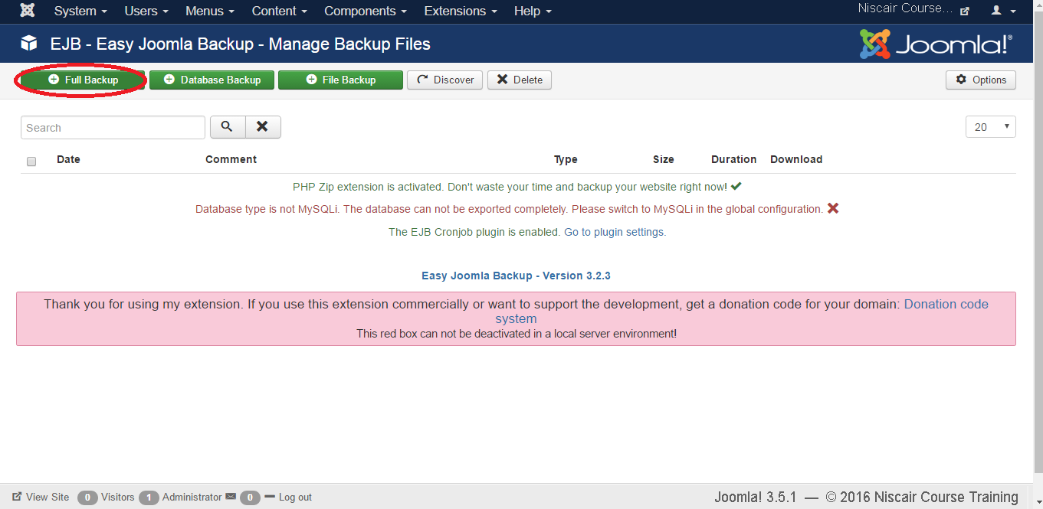
Step(6): Click on Components-> EJB –Easy Joomla Backup, then you will get
the following screen

Slide 13
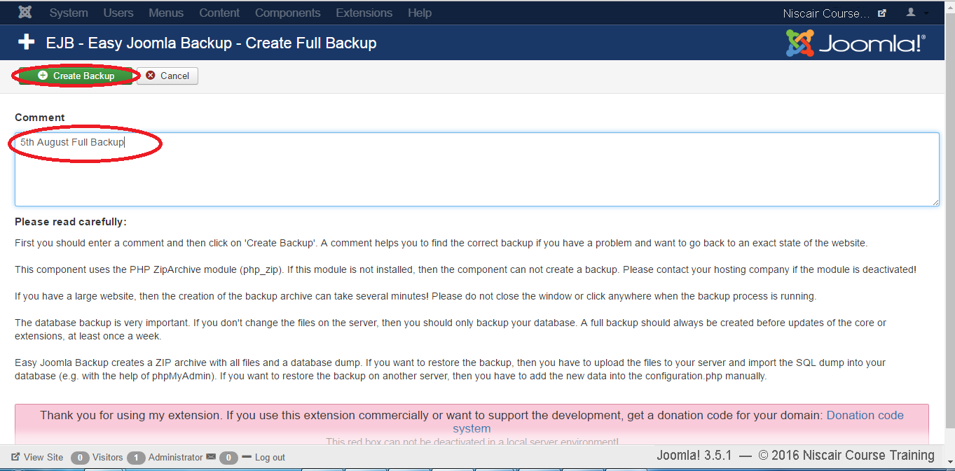
Step(7): Here you can click the any of the button shown in the above screen
,as per your requirement and you will get the following screen

Slide 14
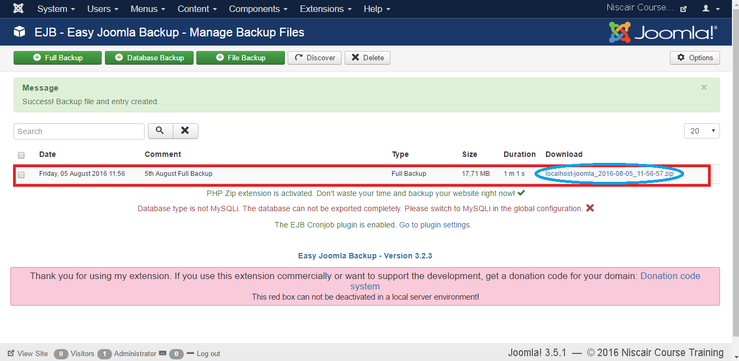
Step(8): Click on Create Backup Button after you have mentioned the title of
the backup as shown in the above screen.

Slide 15
SEO
SEO is short for search engine optimization.
Search engine optimization is a methodology of strategies, techniques and tactics used to increase the amount of visitors to a website by obtaining a high-ranking placement in the search results page of a search engine (SERP) -- including Google, Bing, Yahoo and other search engines.

Slide 16
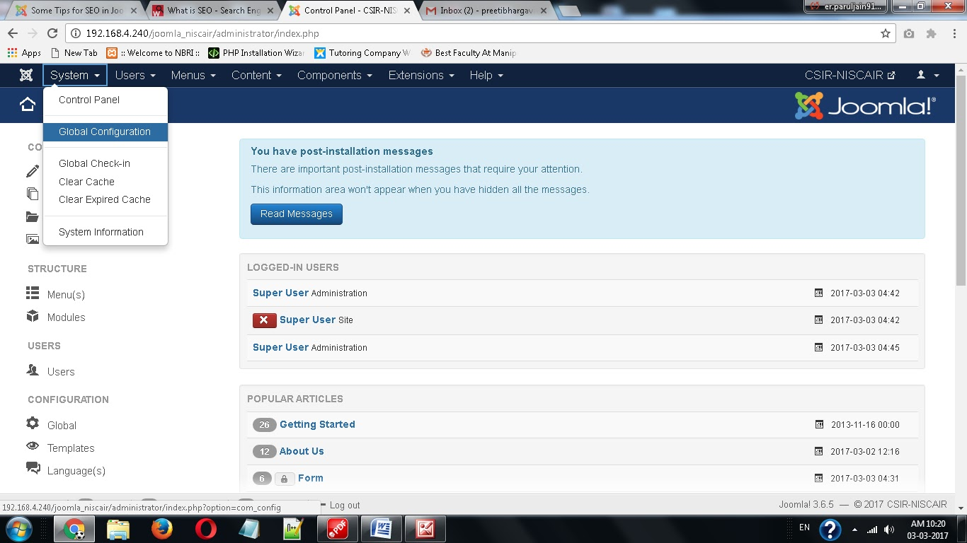
Steps to set Joomla website SEO :
Step (1): Login as Administrator
Step (2) : Go to System → Global Configuration

Slide 17
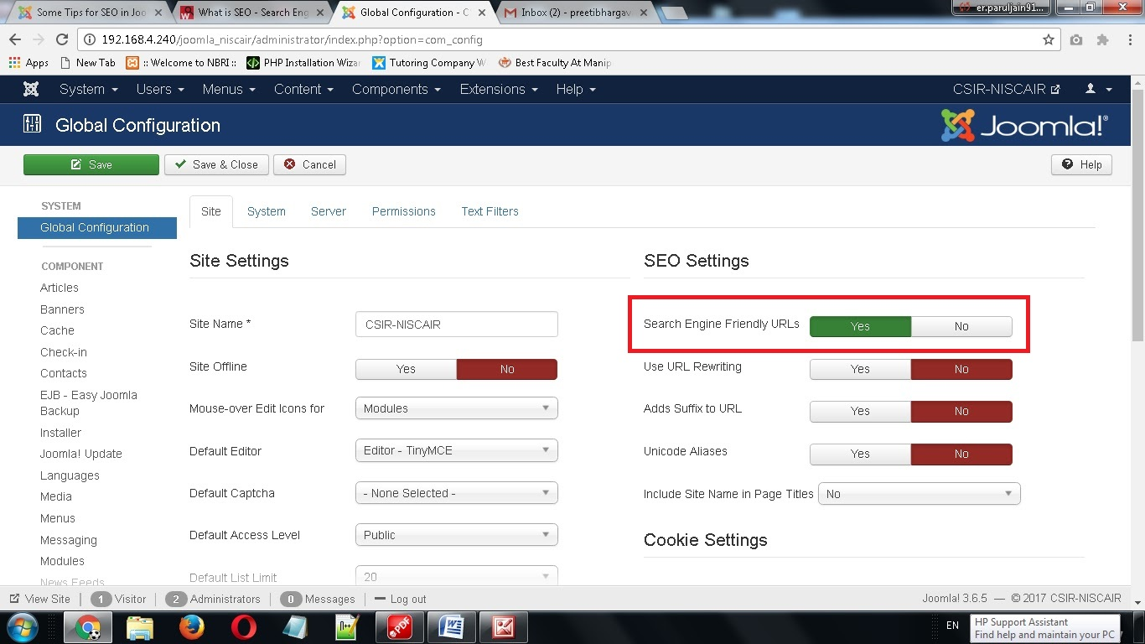
Step (3) : Under Site Tab → SEO Settings → Select “Yes” for Search Engine Friendly URLs

Slide 18
Following are the details of the fields present in the SEO Setting :
Search Engine Friendly URLs: Optimizing the URLs to the search engine.
Use URL rewriting: Selecting the server, which rewrites the URLs to meet a specific condition.
Adds Suffix to URL: Based on the document type, the suffix to the URL is
added.
Unicode Aliases: It selects between the transliteration and Unicode aliases.
Include Site Name in Page Titles: Provide your site name on all pages at
the beginning or end of the page.

Slide 19
GENERAL SEO BEST PRACTICES
Create Your Title Tags : The Title tag is what shows up in the search engines as click able headlines for your page. Make sure the title tag includes at least your main keyword.
Don’t Use too many keywords in your pages: It’s necessary to have some keywords in your posts. However, this must not be overdone. You can use the keyword suggestion tools such as: Keyword tool - Google Adwords, Word Tracker.
Use Meta tags for Joomla Website: The Metadata Settings are in Global Configuration of Joomla Setting. The important Meta elements are the tittle tag and Description tag.Take your time and keep the title tag to should not exceed 70 characters, and the description length should around 150 characters. After that, let your primary keywords put in your title and description tag.
Gets Lots of internal and external linking: Try to get both internal and external links from relevant sites. You can create compelling content that the readers want to share with others. If the content is good, bloggers and other site owners will link to it.
Create a sitemap to get Index Google: You must create a sitemap, an xml file that contains links to every page on your site. After you have created a sitemap, you must submit your site and your sitemap to Google. When your website is new, Google will crawl the sitemap that you submit and after that, Google will be able to read your website's content faster.

Slide 20
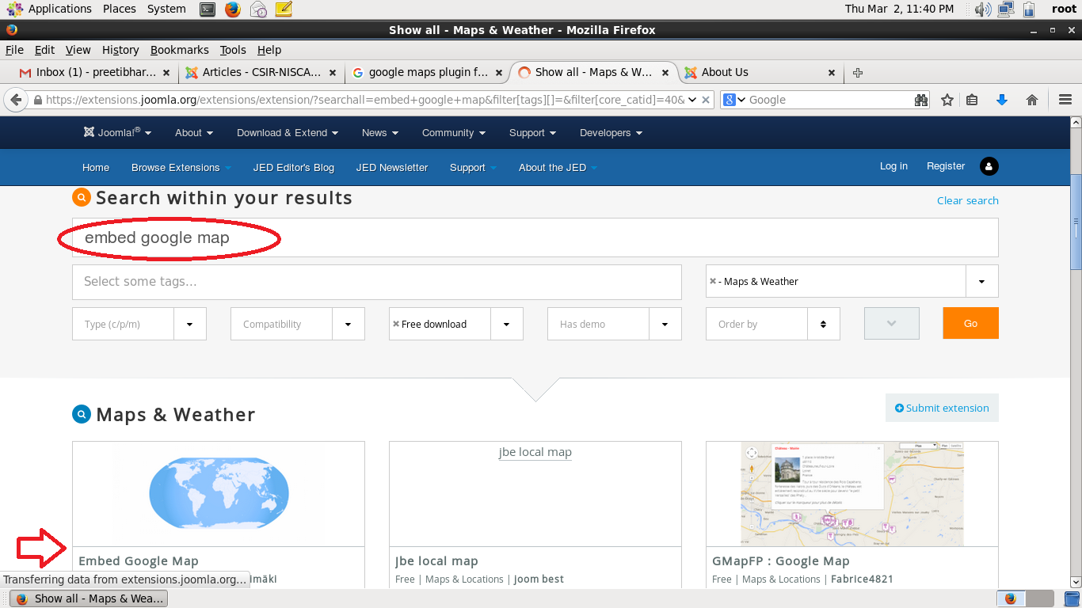
EMBED GOOGLE MAP
The Embed Google Map plugin will allow you to embed different maps to articles on your Joomla 3.x website. It is an easy thing to do using the plugin and you will not have to make much modifications for that purpose.
Step (1): Download required extension (Embed Google Map) from https://extensions.joomla.org

Slide 21
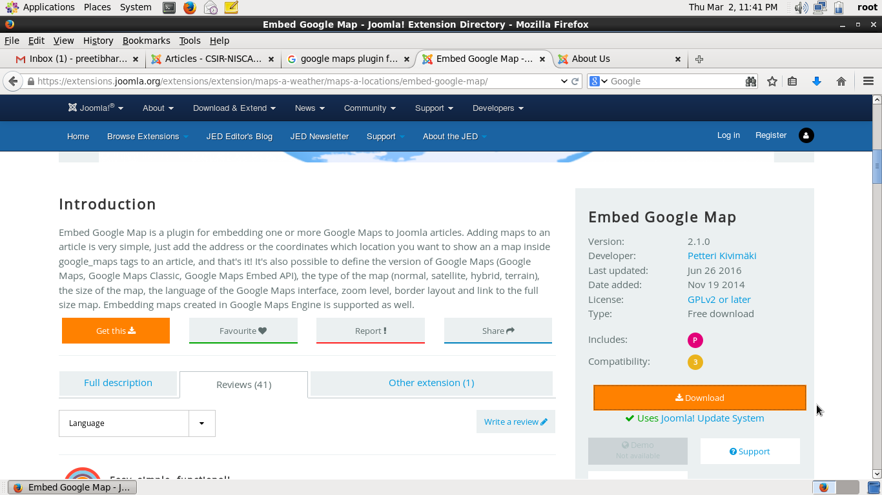
Step (2): Select the extension → Click on Download

Slide 22
Step (3) : Go to Extensions → Manage → Install

Slide 23
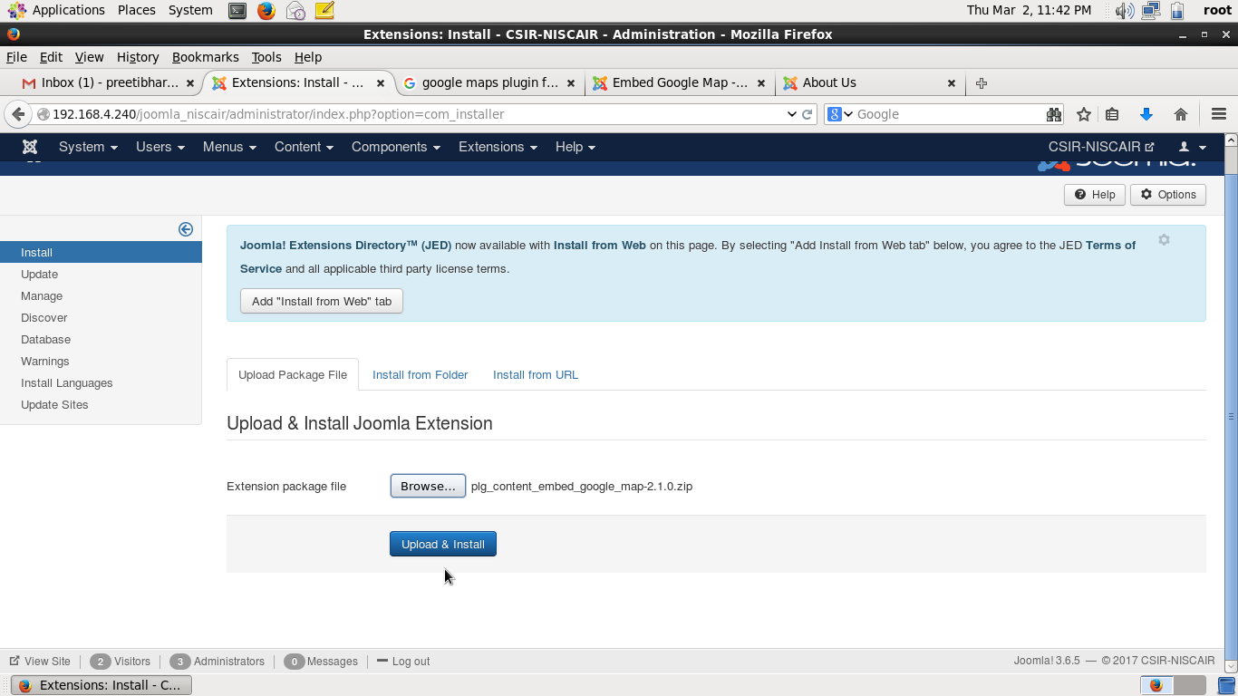
Step (4) : Click on Tab “Upload Package File” and browse and upload zip file downloaded for extension . Click on “Upload and Install”

Slide 24
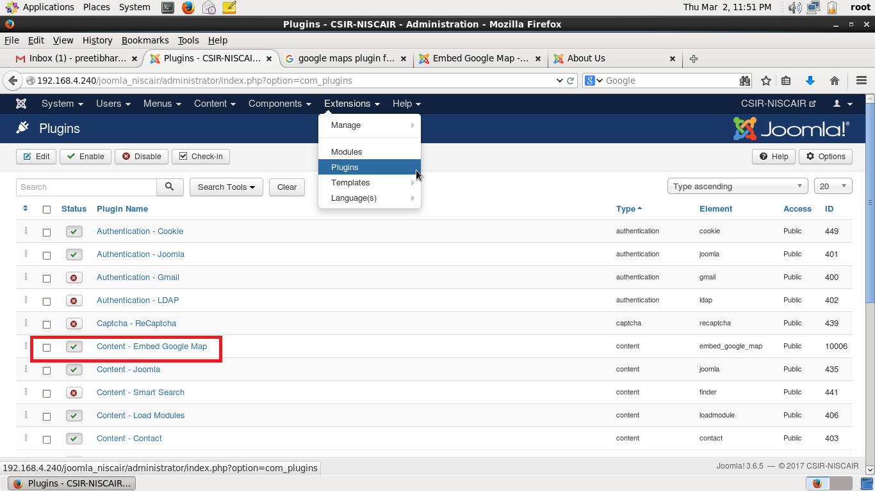
Step (5) : Go to Extensions → Plugins.
Enable Content-Embed Google Map Plugin by Clicking on red “x” Symbol

Slide 25
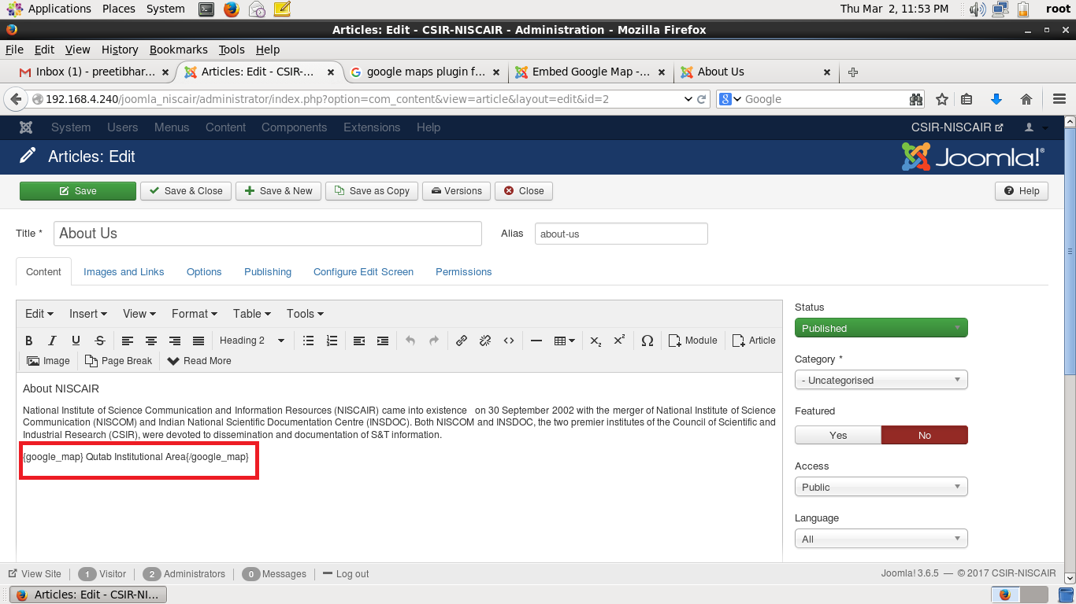
To use it, you simply need to create a new article or edit the already created article and enter the address to be used within {google_map} tag.
Step (6): Go to Contents → Articles and Edit the article “About Us”
Embed a Google map to your article and specify the address as Qutab Institutional Area, you need to enter the following line to the article:
{google_map}Qutab Institutional Area{/google_map}
Save & Close the article

Slide 26
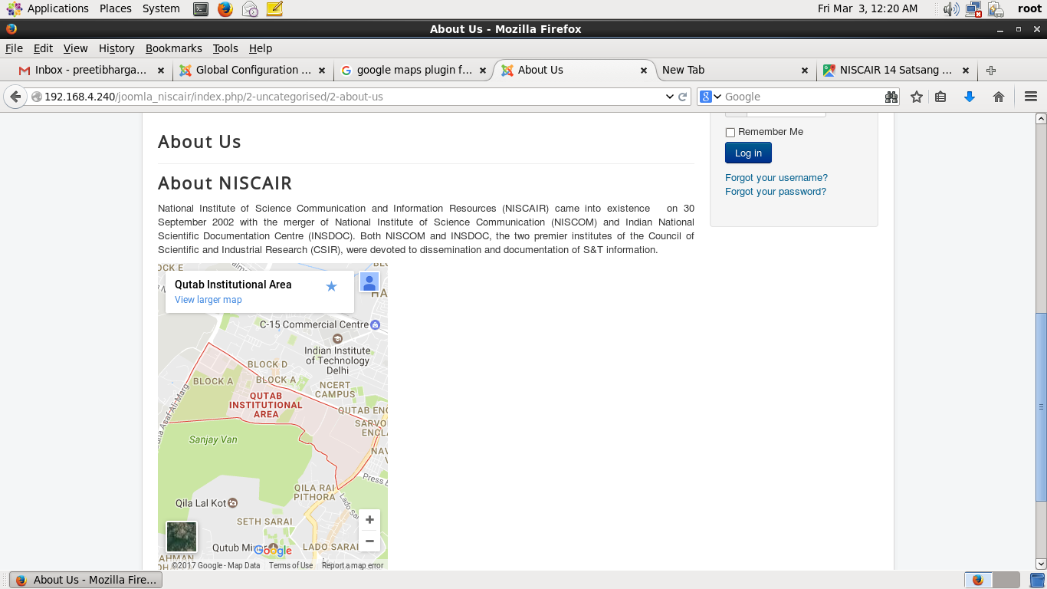
To View, Go to Site View and Click on Article “About Us”

Slide 27
Thank You

