Slide 1
CONTENT MANAGEMENT SYSTEM
Presented by:
Mukesh A. Pund
Sr. Principal Scientist
CSIR-NISCAIR, New Delhi

Slide 2
ARTICLE CREATION, MANAGEMENT
FORMATTING ARTICLE, CATEGORY

Slide 3
ARTICLE
In Joomla an Article is a piece of content consisting of text (HTML), possibly with links to other resources (for example, images). Articles are the basic units of information in the content system and the bottom level in the content hierarchy. Since Joomla! , each Article is in exactly one Category. A Category can be in another Category making it a sub Category. It is also possible to have Uncategorized Articles. These articles exist without being associated with any Category.

Slide 4
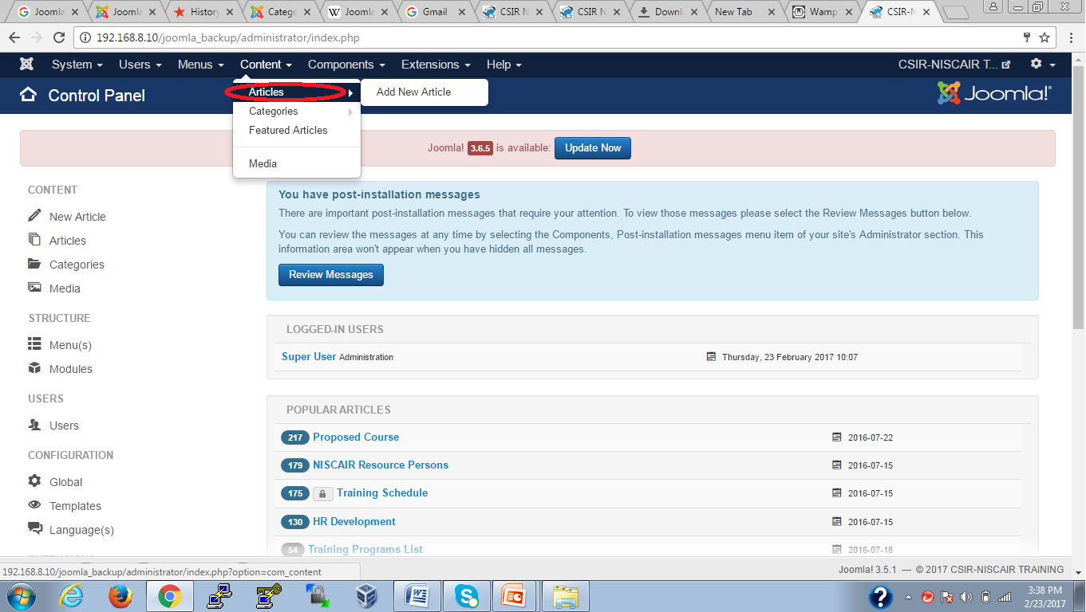
ADDING CONTENT
Step (1): Click on Content --> Article as shown below.

Slide 5
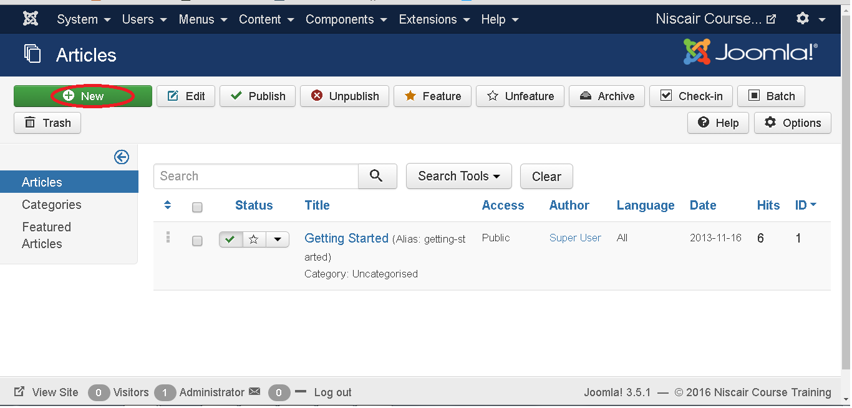
Step (2): After clicking on Add New Article, you will get the following screen as follows

Slide 6
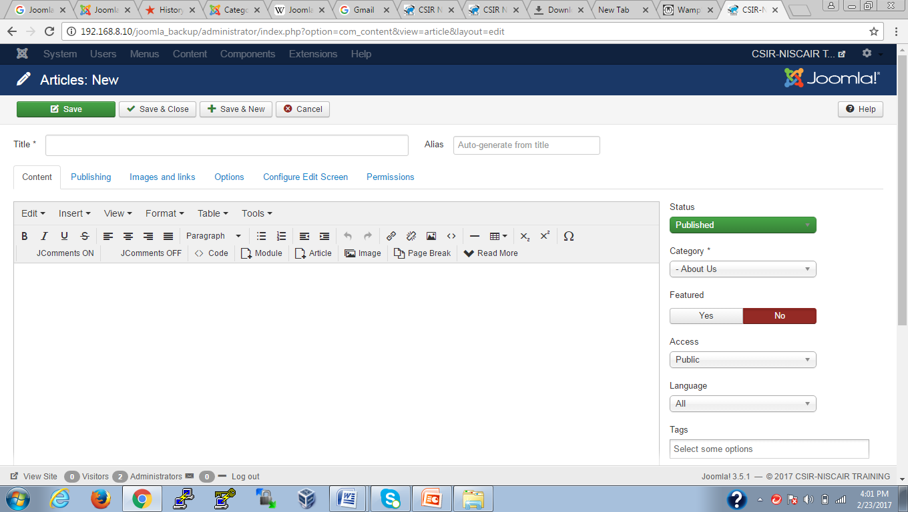
Step (3): After clicking on New button ,as shown in the above screen, you will get the editor page of the Article as shown below.

Slide 7
Following are the details of the fields on editor page of the Article .
Title: It is used to write the title of the article. This title gets displayed on the page.
Alias: It is auto generated from the given title name.
TinyMCE editor
It is a WYSIWYG Editor, which is similar to a word processor interface where
we can edit the contents of the article.

Slide 8
First Row: They appear on the top of the Editor page and contains a group of related commands:
Edit: Undo, Redo and Cut, Copy, Paste, Select all.
Insert: Insert image, Insert link, Horizontal line, Special Character.
View: Visual Aids.
Format: Bold, italic, underline and various formats are available in this group.
Table: It is used to display the table format in the article by using rows and columns.
Tools: It displays the source code of your article in html format and the code will be displayed in a new popup window.
Second Row: In this row, we can see that there are 4 buttons present:
The first button is used to make font bold, italic, underlined and strikethrough.
The second button is used to do the alignment of the content i.e. left, center, right and full.
The third button is used to select pre-defined format for the text i.e. paragraph, heading, text or pre.
The fourth button is used to display the list format either by using bullet or numbers.

Slide 9
Third Row:
The first button is used for indentation of paragraphs or text, either indent to the left side or right side.
The second button is used to undo or redo the content.
The third button is used to insert or remove the link, insert images and display the source code of your article in html format.
The fourth button is used to add a horizontal line and add tables by using a dropdown option.
The fifth button is used to superscript and subscript the text.
The sixth button is used to insert the special character in the text.
Details
Category: It is used to select the category for your article.
Tags: It is used to display the tags on the front-end page.

Slide 10
Status: You can select any of the following status for your article
Published: Items get published on the website.
Unpublished: Items do not get published on the website.
Archived: Items will not get displayed in the menu list as well as on blogs.
Trashed: Items will be deleted from the site.
Featured: It is used, whether to display the article on the home page or not by using the buttons YES/NO.
Access: You can select an access level for your item from the list box.
Language: It selects the language for its item.
Version Note: It is used to note the version of the item. It is optional.
Text Insertion
It is used for writing the content of an article.
Editor Buttons Five buttons present in the third row at the top of the text editor as shown below are the editor buttons.

Slide 11
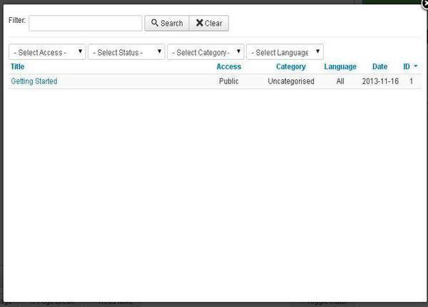
Article Button: Click on Article button, a window pops up as shown below. Here, we can select the required article to view.

Slide 12
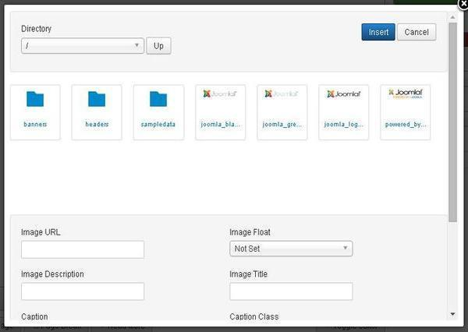
Image: Click on the Image button, a window pops up as shown below. Here, you can add the details of the images. After filling all the fields, click on Insert Button.

Slide 13
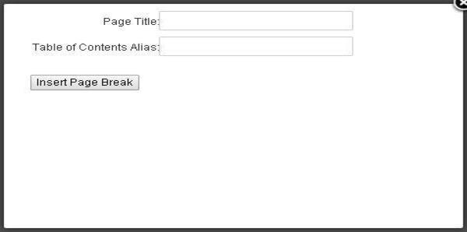
Directory: Search the particular directory present in image folder.
Image URL: Insert image URL.
Image Description: Write brief description about particular image.
Image Title: Write the name of the image.
Image Float: Set the image location.
Caption: Write a caption for the image.
Caption Class: It calls Joomla libraries to load the image.
Page Break: Click on Page Break button, a window pop-up will get displayed as shown below.

Slide 14
Page Title: Enter the title of the page.
Table of Contents Alias: Enter the table content alias.
Read More: Click on the Read More button. The red dotted line gets displayed in the editor. The further information part of the article gets displayed after the read dotted lines or sometimes it displays the entire article.
Toggle editor: TinyMCE editor will get displayed or its get invisible.
Toolbar Following are the toolbar options:
Save: Saves the contents and stays on the same screen.
Save & Close: Saves the content and closes the screen.
Save & New: Saves the content and opens a new content page.
Save as Copy: Saves the formatted content and copies it.
Cancel: Cancels the content changes made into it and returns to the previous screen without saving.

Slide 15
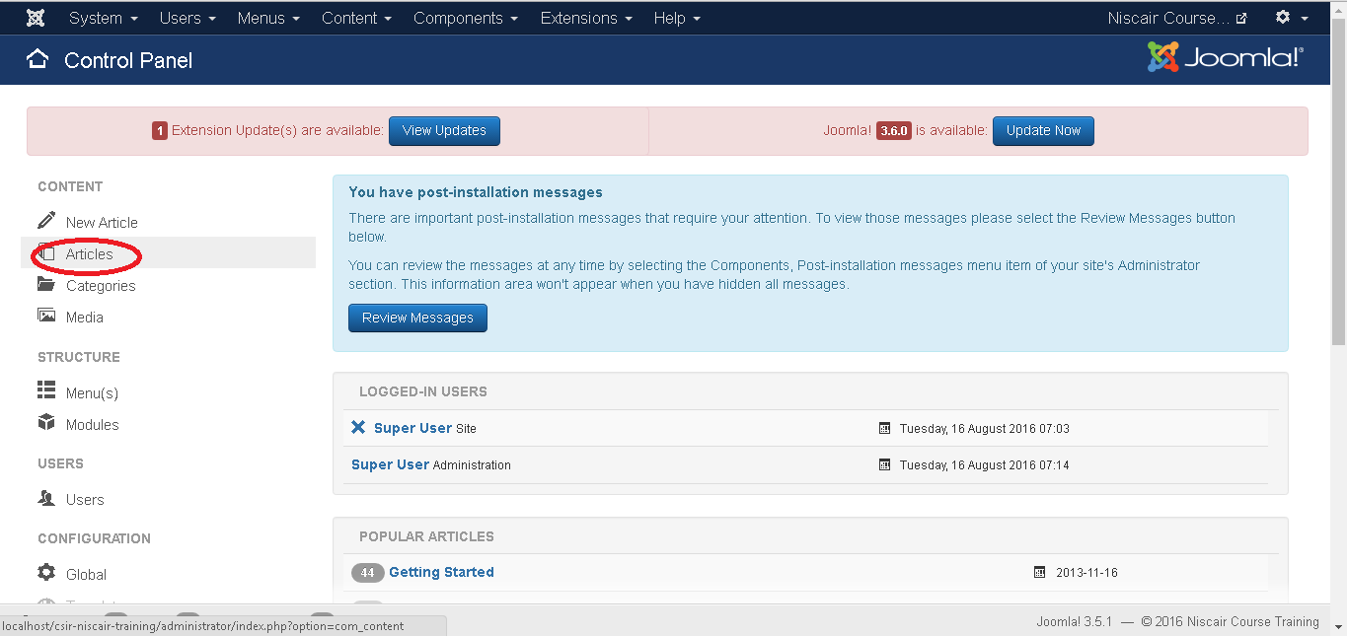
FORMATTING CONTENT
Step (1): Click on Article in Control Panel as shown below.

Slide 16
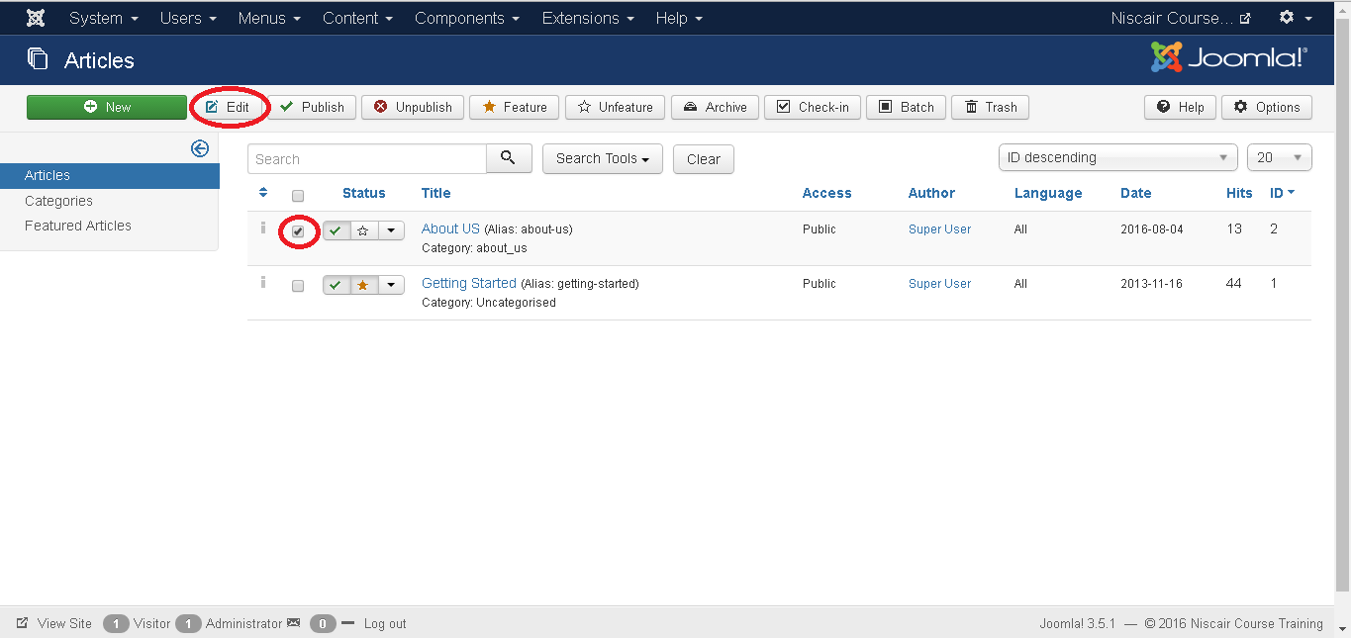
Step (2): Select the article to be formatted by clicking on the checkbox. Next, click on the Edit button as shown below.

Slide 17
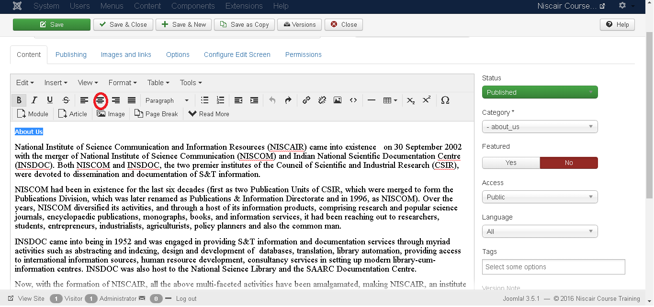
Step (3): Next, the article opens up for editing as shown below. Here we are aligning the heading About us in center using center alignment. Similarly, you can edit the image.
Toolbar
Following are the toolbar options:
Save: Saves the contents and stays on the same screen.
Save & Close: Saves the content and closes the screen.
Save & New: Saves the content and opens a new content page.
Save as Copy: Saves the formatted content and copies it.
Versions: It is used to select versions of the page.
Close: Closes the article without formatting.

Slide 18
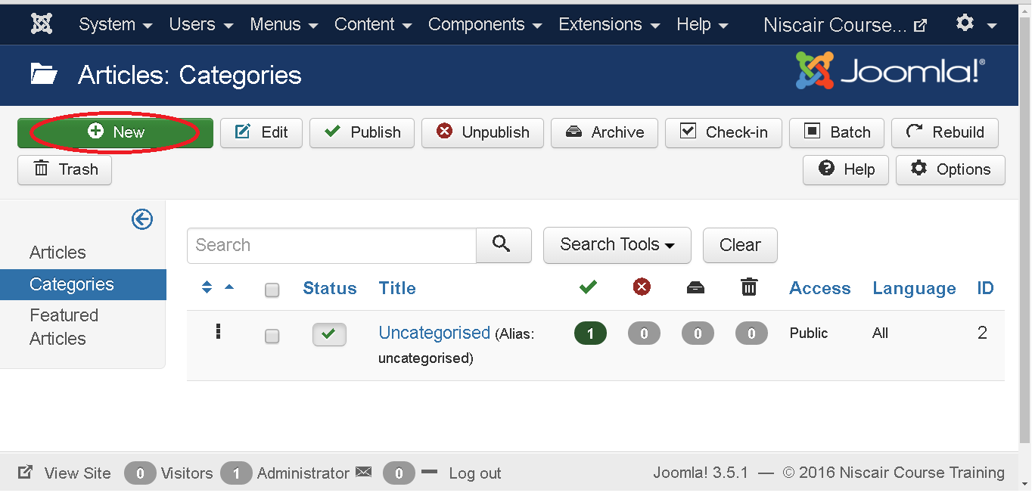
CATEGORY
Category is used to create categories for the articles which allows grouping your content better. Click on Content --> Category menu on the Joomla administrative panel, then you will get the following screen image:

Slide 19
Here, we have mentioned the details about the column header present on the Category Manager page.
Checkbox: It is used to select one or more category items by clicking on the box.
Status: Specifies the status of the category i.e. Publish/Unpublish.
Title: Specifies the name of the title in the category.
Access: Specifies the access level, i.e. Public or Private.
Language: Specifies the item language used.
ID: It is the unique identification number assigned to the items automatically.

Slide 20
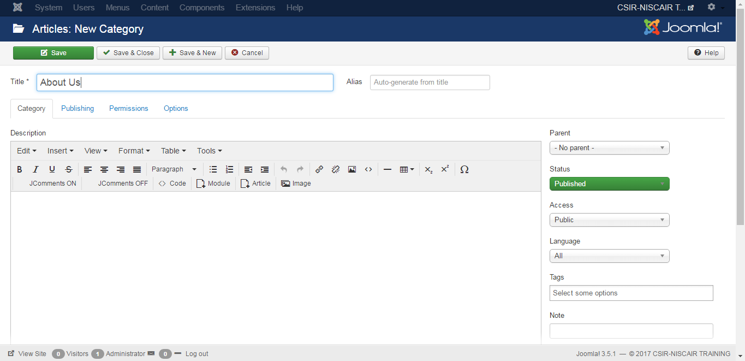

Slide 21
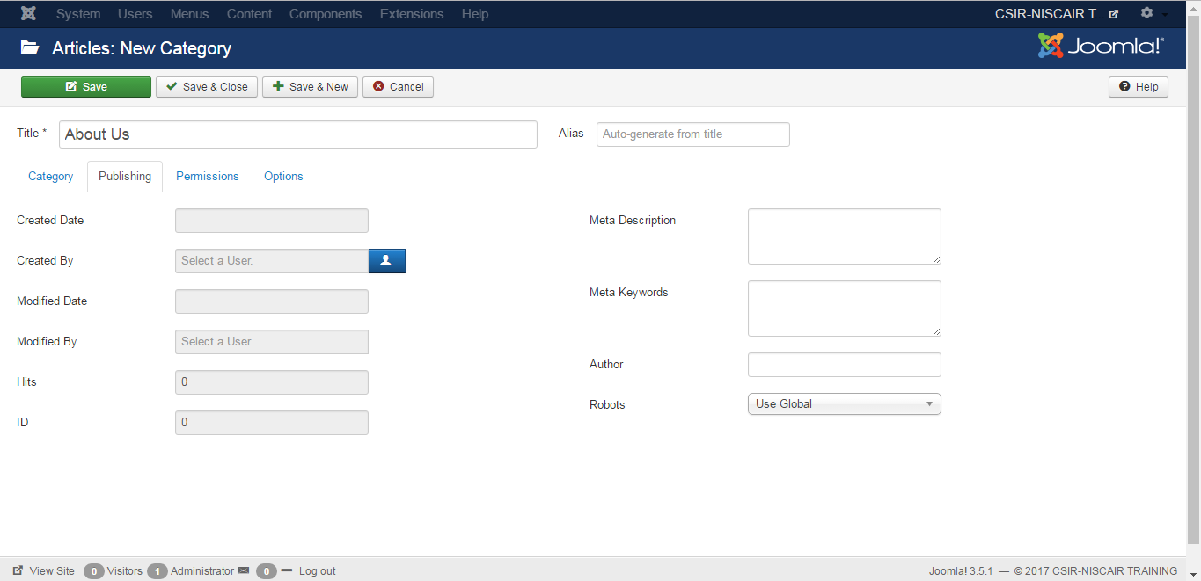

Slide 22
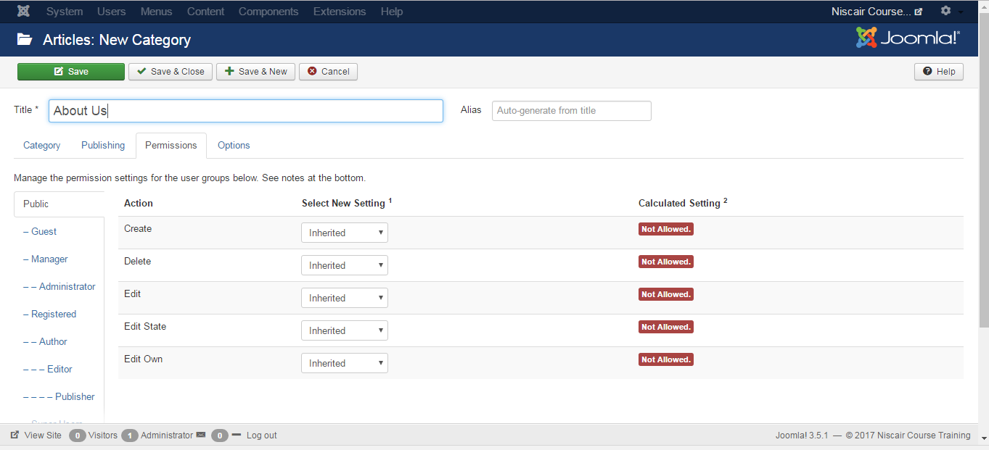

Slide 23
Thank You

