Slide 1
CONTENT MANAGEMENT SYSTEM
Presented by:
Mukesh A. Pund
Sr. Principal Scientist
CSIR-NISCAIR, New Delhi

Slide 2
JOOMLA
FORUM WEB LINKS PLUGIN

Slide 3
FORUM
Establishing a sound business communication with your existing customers and targeted clients is considered key to business strategy. The more you get a chance to communicate with the audience, the more you feel what they expect from you. Now the question is. What is the effective way to reach to customers easily? The answer is managing an interactive forum on your website.
You don’t need to know a single line of code to add a forum to your Joomla site.
The only thing you have to install the extension and configure them to your specification.

Slide 4
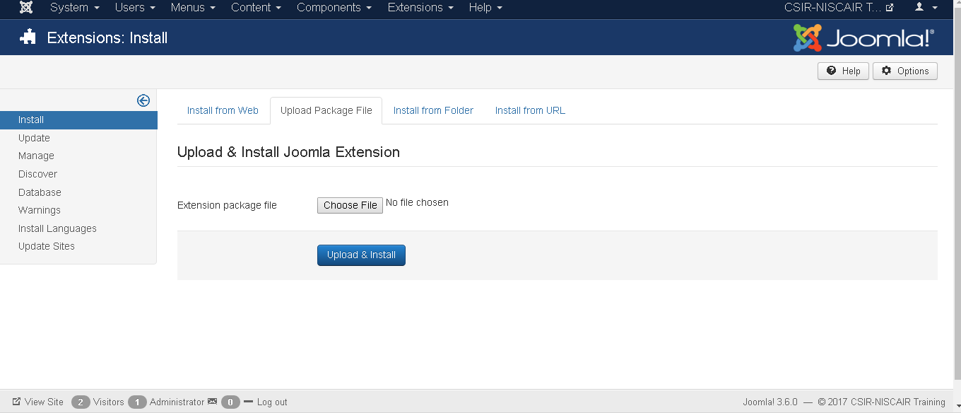
ADDING FORUM
Step(1):To add a forum in your Joomla website, you have to download discussion extension first. and then install the extension via Extension >Manage > Install > from the Joomla Back-end.

Slide 5
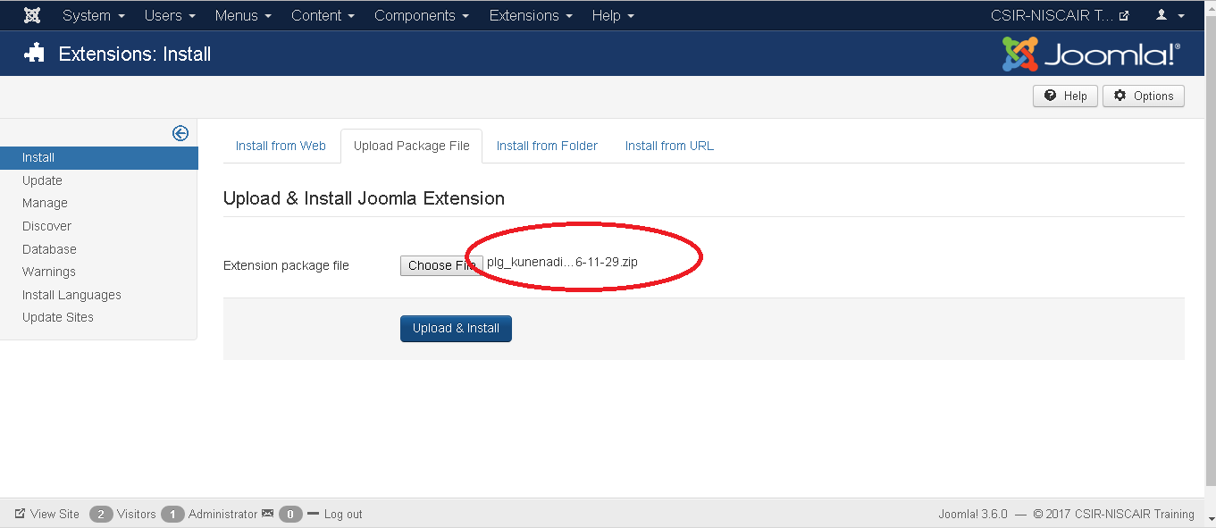
Step (2): Click on Choose File button and choose the extensions forum you have downloaded to include in your web site. After choosing the file, click on Upload & Install button.

Slide 6
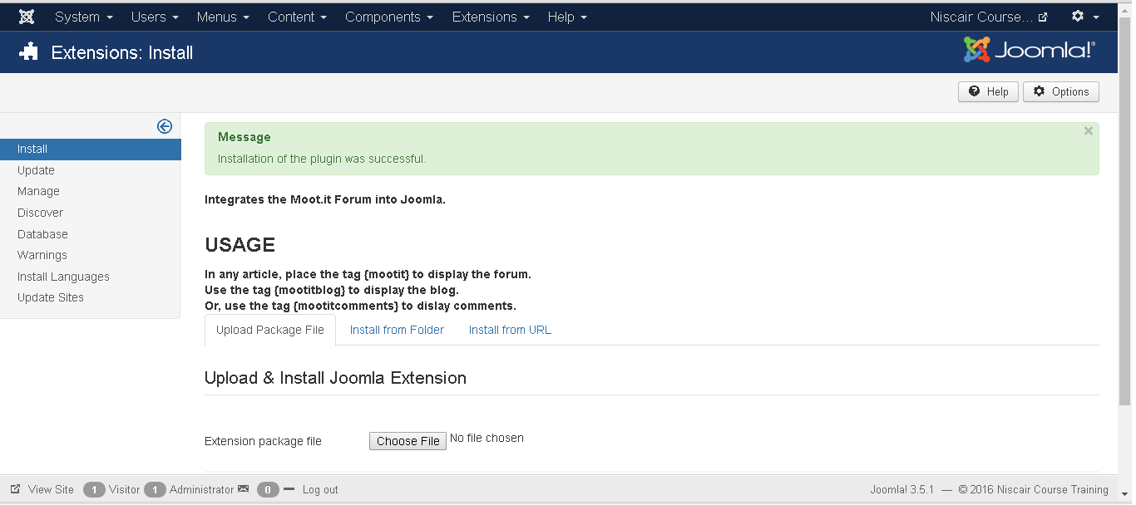
Step (3): Joomla starts installing the Forum extension for your site. After the installation is complete, you get the screen below showing the success message.

Slide 7
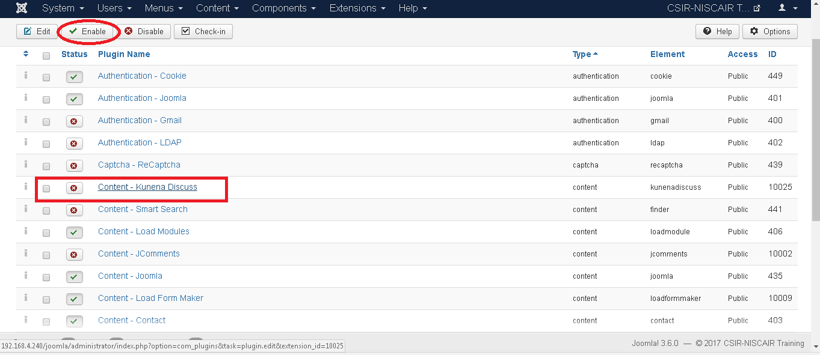
Step (4): Click on Extension → Plugin , then you will get the following screen ,select the check box against plugin name and then enable it

Slide 8
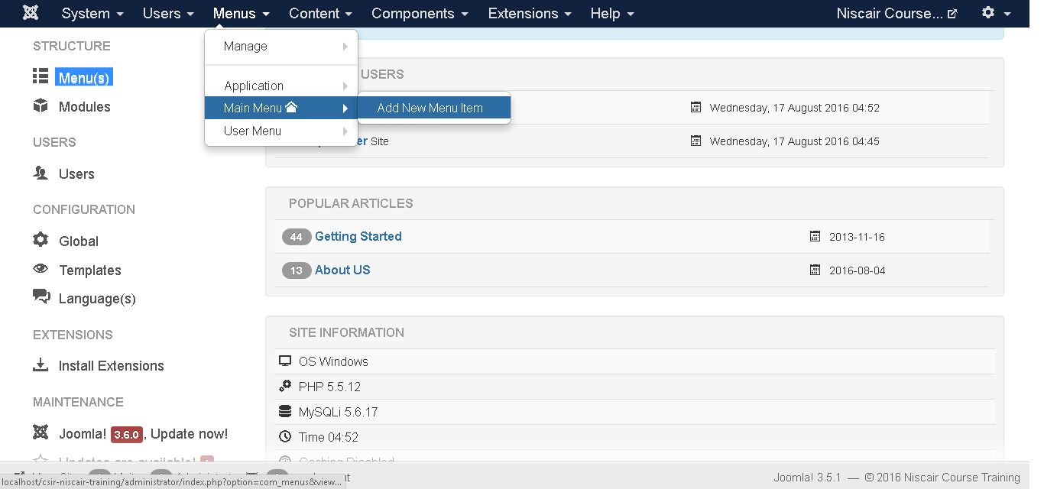
Step (5): Click on Menus-> Main Menu->Add New Menu Item

Slide 9
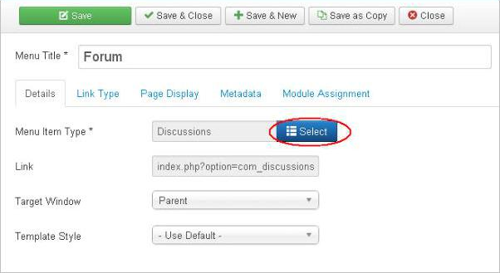
Step (6): In add menu item page, specify Menu Title, click on Select button to the forum extension for your website.

Slide 10
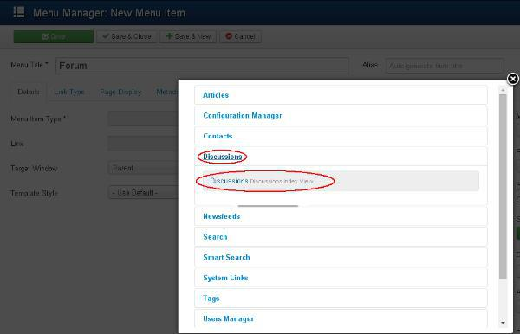
Step (7): Click on the Discussion and choose the Discussion discussion index views.
Toolbar
Given below are few details about the toolbars present in Forum.
Save: Saves your forums.
Save & Close: Saves the forums and closes the current screen.
Save & New: Saves the forums and opens a new create forum screen.
Cancel: Cancels the created forums in Joomla.

Slide 11
WEB LINKS
The Web Links allows you to add, edit and remove links to other web sites on your Joomla! web site, and organize them into categories. You can then display these links on your site, and optionally let visitors add new links.
The Weblink Component was already decoupled for Joomla Core in v3.4.0. You can reinstall it if you like. You find it on: https://extensions.joomla.org/category/official-extensions/

Slide 12
Step(1):To add a Weblink in your Joomla website, you have to download weblink extension first. and then install the extension via Extension >Manage > Install > from the Joomla Back-end.
Step (2): Click on Choose File button and choose the extensions weblink you have downloaded to include in your web site. After choosing the file, click on Upload & Install button.

Slide 13
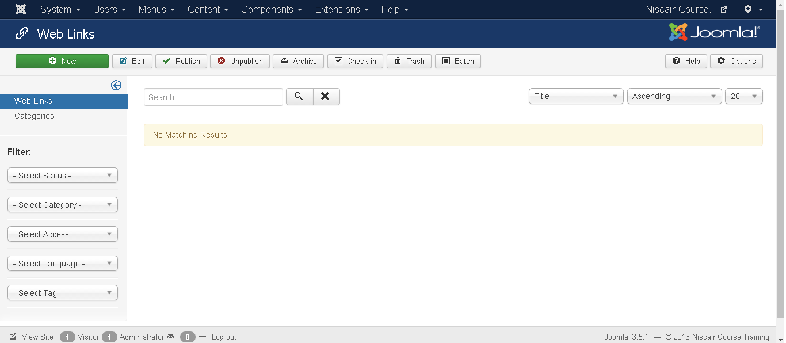
ADDING WEB LINKS
Step (1): Click Components --> Weblinks --> Links in Joomla administrator. After clicking on Links, you will get the following screen.

Slide 14
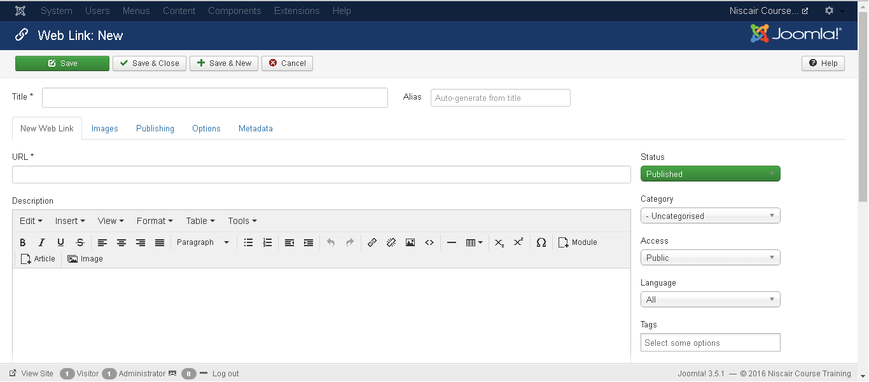
Step (2): Next, click on New button, you will get the following screen.
Here there are different tabs present. By default, the New Web Link tab is
displayed.
URL: Enter the URL link, after saving, it gets converted to Punycode.

Slide 15
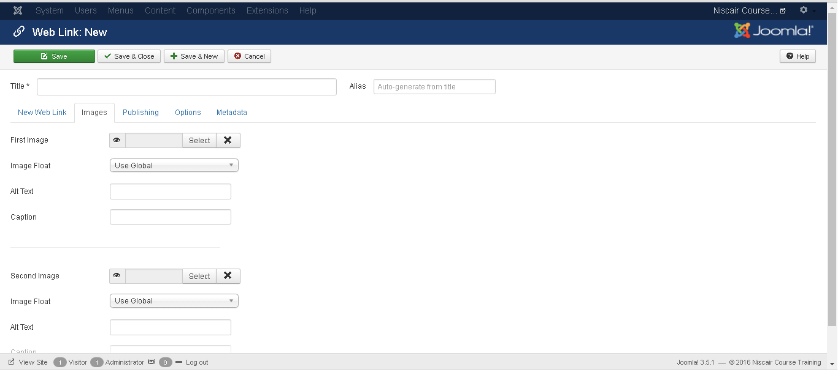
Step (3): In Images tab, you will get the following screen.

Slide 16
The following fields are present on the Images tab:
First image: Click on the Select button to select an image to display with an item on a web page.
Image Float: Sets place for the image i.e. Use Global, Right, Left and None respectively.
Alt text: Alternative text is present without access to images.
Caption: Entered text will display below the image.
Second image: Click on the Select button to select the second image to display with an item on a web page.
Image Float: Sets place for the image i.e. Use Global, Right, Left and None respectively.
Alt text: Alternative text is present without access to images.
Caption: Entered text will display the below image.

Slide 17
Step (4): Click on Publishing tab, you will get the following screen.
The following details are present on the publishing tab:
Start Publishing: It indicates the date on which the Weblinks are to be published on the web page.
Finish Publishing: It indicates the date on which the Weblinks are to be stopped from being published on the web page.

Slide 18
Created Date: It indicates the created date of the Weblinks.
Created by: It indicates the name of the user who has created the Weblinks.
Author's Alias: It indicates the name of the Author's Alias who has created the things required in Weblinks.
Modified Date: It indicates the last modified date of the Weblinks.
Modified by: It indicates the name of the user who has last modified the Weblinks.
Revision: It indicates the number of revisions for the Weblinks.
Hits: It indicates the number of times the Weblinks have been viewed.
ID: It indicates the unique identification number assigned to the Weblinks automatically.
Meta Description: It specifies the detail description of the page.
Meta Keywords: It specifies the different Meta keywords and it should be represented either by lowercase or uppercase.
External Reference: It specifies to use the external reference.
Robots: It specifies the instructions to the user to browse the web page.
Content Rights: It specifies the rights of the content so that others can use it.

Slide 19
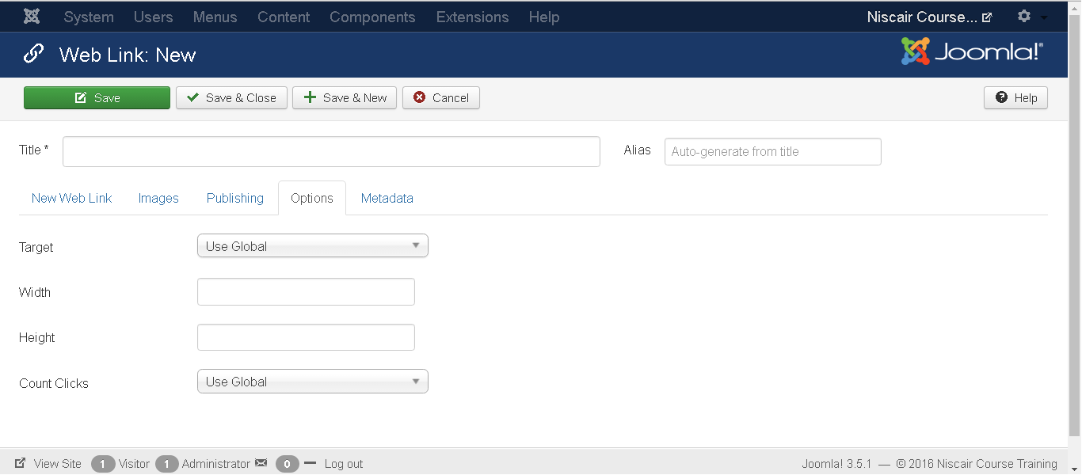
Step (5): After clicking on the Options tab, you will get the following screen.
The following details are present on the Options tab:
Target: It is used to open a Weblink with either of the commands - Use Global,
Open in the parent window, Open in the new window, Open in the popup and Modal.
Width: Sets the width of modal window.
Height: Sets the height of modal window.
Count Clicks: It counts the number of Weblinks that has been opened.

Slide 20
PLUGIN
A plugin is a kind of Joomla! extension. Plugins provide functions which are associated with trigger events. Joomla provides a set of core plugin events, but any extension can fire (custom) events. When a particular event occurs, all plugin functions of the type associated with the event are executed in sequence. This is a powerful way of extending the functionality of the Joomla! Platform. It also offers extension developers a way to allow other extensions to respond to their actions, making extensions extensible.
The Joomla! plugin architecture follows the Observer design pattern. The JPlugin class provides the means to register custom plugin code with core or custom events. The JDispatcher class (JEventDispatcher in Joomla 3.x) is an event handler which calls all plugins registered for a particular event, when that event is triggered.

Slide 21
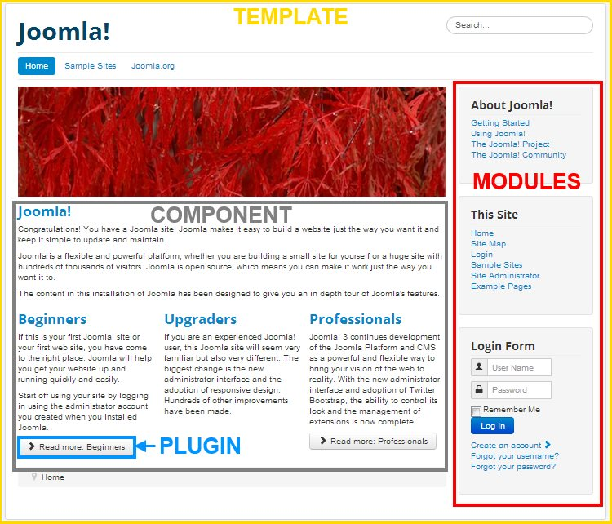

Slide 22
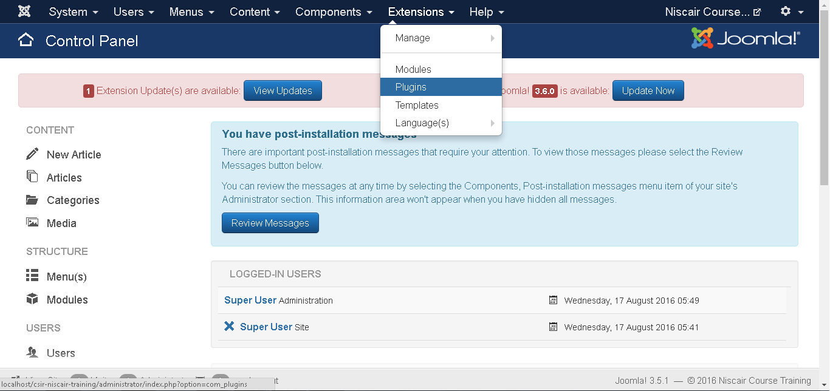
Step (1): Click on Extension --> Plugin in Joomla administrator as shown below.

Slide 23
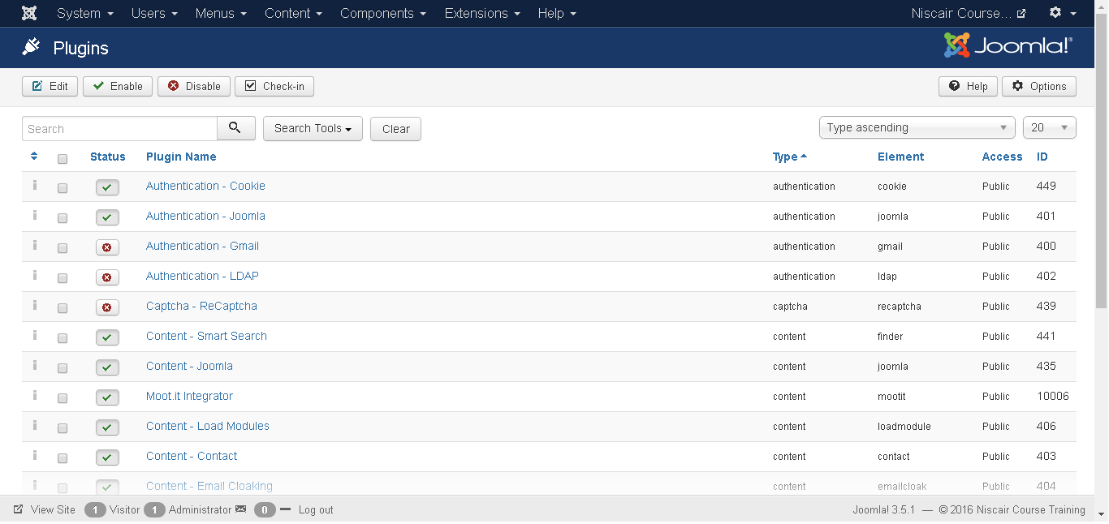
Step (2): After clicking on the Plugin , an existing Joomla plugin will be
displayed as shown below.
Toolbar
Following are the toolbar options in the Plugin:
Edit: Edit the plug-in.
Enable: Enable the plug-in to use on the website.
Disable: Disable the plug-in which are not necessary on the website.
Check In: Used to check in the plug-in and after completing the process displays the successful message.

Slide 24
Thank You

