Slide 1
CONTENT MANAGEMENT SYSTEM
Presented by:
Mukesh A. Pund
Sr. Principal Scientist
CSIR-NISCAIR, New Delhi

Slide 2
JOOMLA
CATEGORY MANAGEMENT, BANNERS,CONTACTS, NEWS FEEDS

Slide 3
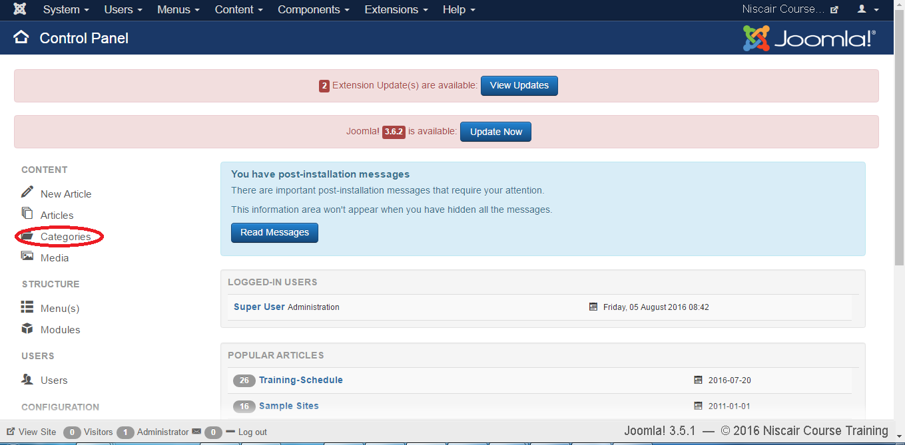
CATEGORY MANAGEMENT
Step (1): Click on Category in Control Panel as shown below.

Slide 4
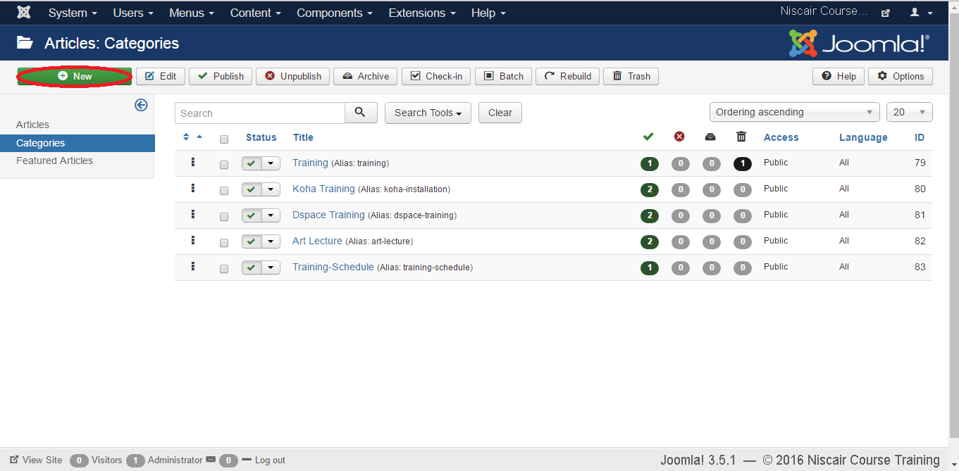
Step (2): After clicking on a Category , you will get the following screen.

Slide 5
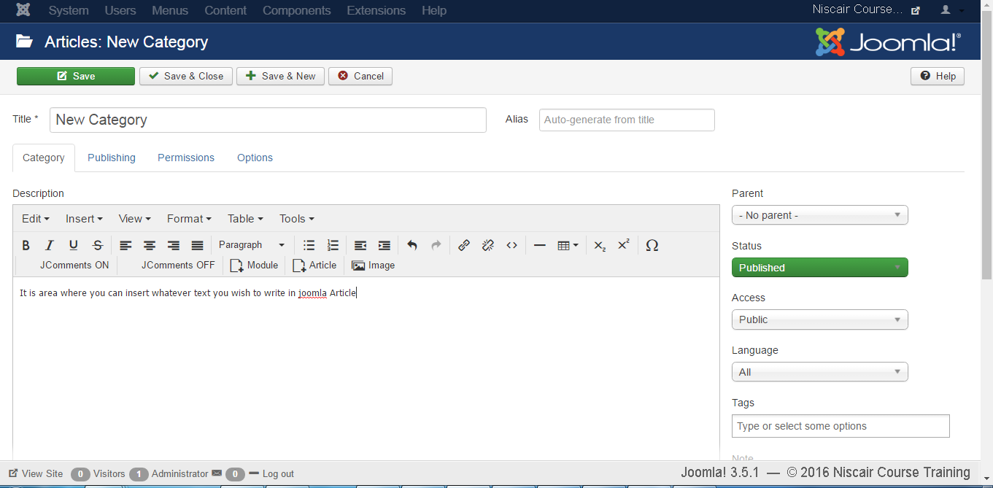
Step (3): Click on New button in the above screen. Following is the basic editor page we get for category . This editor is explained in detail in the article Joomla - Adding Content. Different tabs are present on this page. By default, the Category tab is displayed.

Slide 6
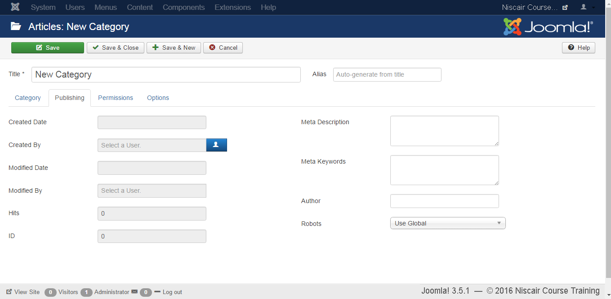
Step (4): In Publishing tab, it gives the information of Joomla category.

Slide 7
Following are the details of the fields present in the Publishing tab.
Created Date: It is the date the category was created.
Created by: It is the name of the user who has created the category.
Modified Date: It is the date the category was modified.
Modified by: It is the name of the user who has modified the category.
Hits: Specifies the number of times the item was viewed.
ID: It is the unique identification number assigned to the items automatically.
Meta Description: It is used to write an explanation of the contents of web pages.
Meta Keywords: Define keywords for search engines.
Author: Specifies the name of the author within the metadata.
Robots: It is the instruction given to the robots that browse the page using commands such as Use Global, Index, Follow, No index, No follow.

Slide 8
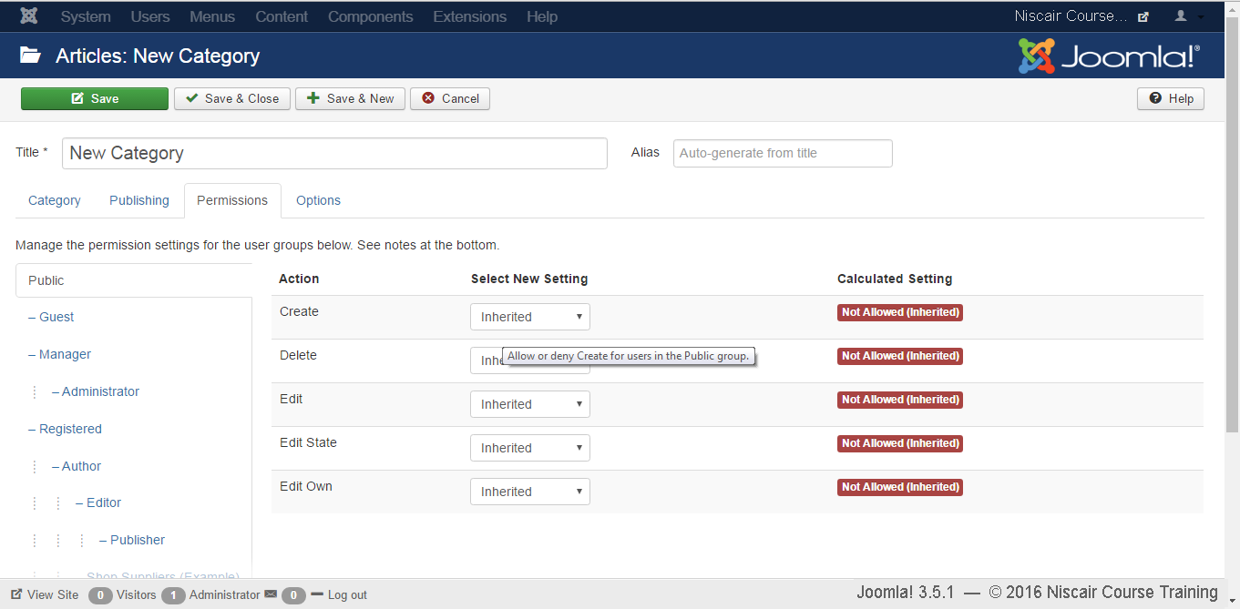
Step (5): In Permission tab, you can set the permission for different user groups for that category.
Create: It allows the users in a group to create the categories.
Delete: It allows the users in a group to delete the categories present in the extension.
Edit: It allows the users in a group to edit the categories present in the extension.
Edit State: It allows the users in a group to change the state of categories present in the extension.
Edit Own: It allows editing the categories which is created by own.

Slide 9
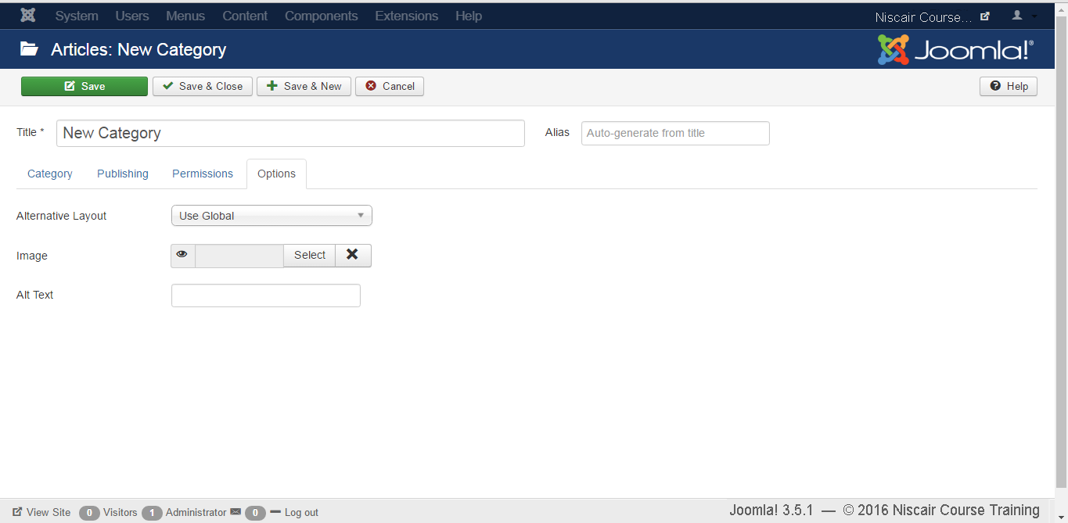
Step (6): In the Options tab, you can choose different layouts for your website.
Alternative Layout: It uses an alternative layout from the supplied component view such as Use Global, Blog and List.
Image: it selects the image to be displayed.
Toolbar
Following are the toolbar options in the Category Management.
Save: Saves your category.
Save & Close: Saves the category and closes the current screen.
Save & New: Saves the categories and opens a new create category screen.
Cancel: Cancels the created category in Joomla.

Slide 10
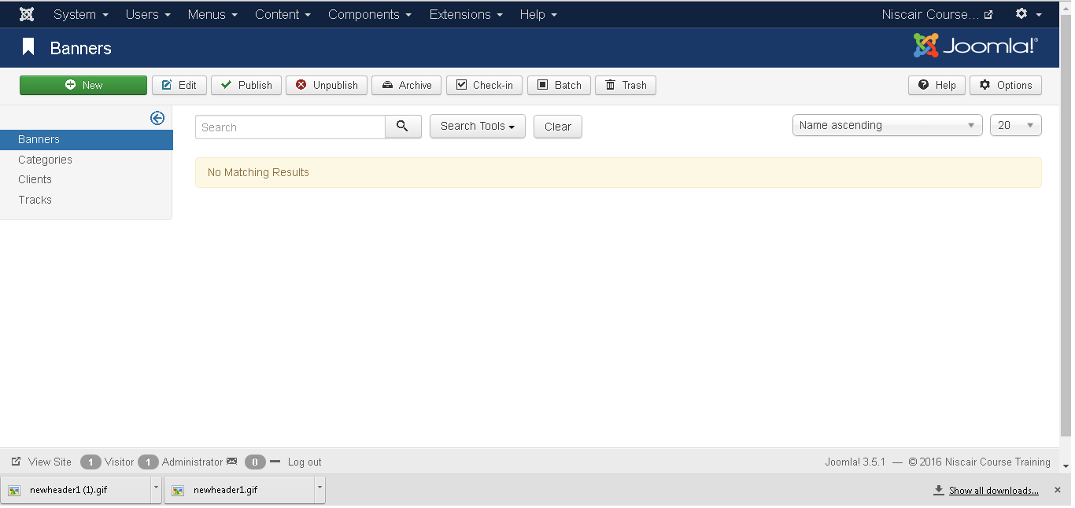
ADDING BANNERS
Step (1): Click Components --> Banners --> Banners in Joomla administrator, you will get the following screen.

Slide 11
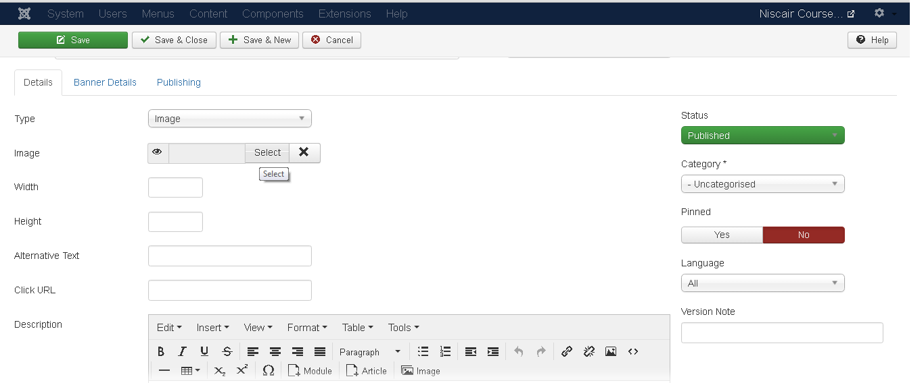
Step (2): Next, click on New button, you will get the following screen.
There are different tabs present in above screen. By default, Details tab is active. This tab displays the details of the banner.

Slide 12
Below we have mentioned the details of the fields present on the Details tab.
Name: This block is used to write the name of the item.
Alias: This is auto generated from the given name.
Type: Displays the banner type i.e. image or HTML code.
Image: Displays the image file of the banner.
Width: Set the width of the banner image.
Height: Set the height of the banner image.
Alternative Text: It represents the alternative text to display on banner image.
Click URL: When user clicks on the banner then it will navigate to the specified URL.
Description: Brief description about the banner.
Following fields are present on the right side of the Details tab.
Category: It displays the category of the banner.
Status: It displays the status of the banner such as Published, Unpublished, Archived and Trashed.
Sticky: It displays whether the banner is Sticky or not. For that we have to select either (Yes/No) button.
Language: It displays the specified language of the banner.
Version Note: It displays the version of the items on the banner.

Slide 13
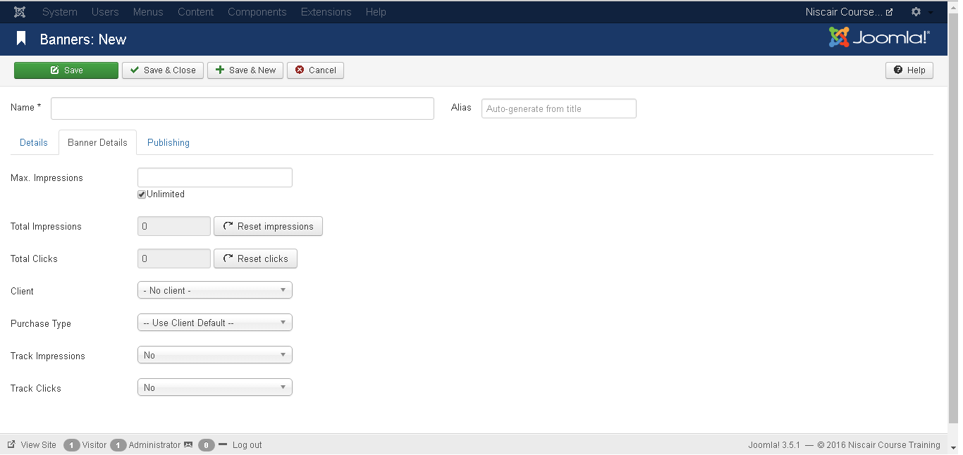
Step (4): After clicking on Banner Details tab, you will get the following screen.
Following fields are present on Banner Details tab.
Max. Impressions: Display the maximum number of impressions purchased for the banner. Unlimited checkbox indicates unlimited number of impressions to be allowed for the banner.
Total Impressions: Shows the total number of banners displayed to a user on a web page. You can reset the Total Impressions to zero.
Total Clicks: Displays the total number of times banners were clicked. You can reset the Total Clicks to zero.

Slide 14
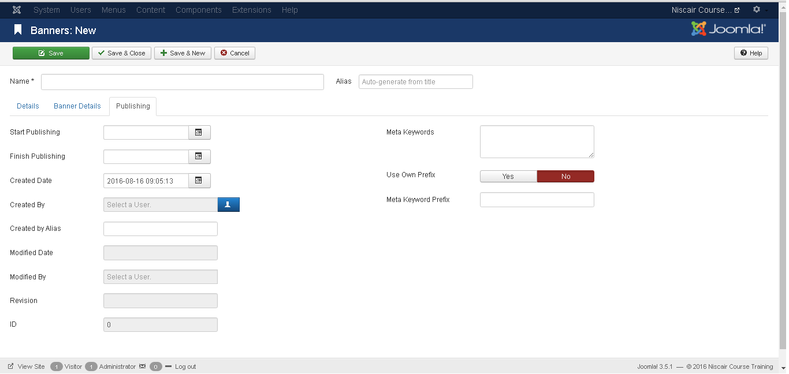
Client: Shows the client for the specified banner.
Purchase Type: It shows the banner purchase type such as Use Client Default, Unlimited, Yearly, Monthly, Weekly and Daily.
Track Impressions: It specifies the number of tracks the banner is displayed on web page.
Track Clicks: It specifies the number of track clicks on the web page.
Step (5): Click on Publishing tab, you will get the following screen.

Slide 15
Start Publishing: It indicates the date on which the banner is to be published on the web page.
Finish Publishing: It indicates the date on which the banner is to be stopped from being published on the web page.
Created Date: It indicates the date on which the banner was created.
Created by: It indicates the name of the user who has created the banner.
Created by alias: It indicates the name of the alias who has created the things required in banner.
Modified Date: It indicates the last modified date of the banner.
Modified by: It indicates the name of the user who has last modified the banner.
Revision: It indicates the number of revisions for the banner.
ID: It indicates the number of identity needed for the banner.
Following fields are present on right side of the Publishing tab.
Meta Keywords: It specifies the different meta keywords and it should be represented either by lowercase or uppercase.
Use Own Prefix: It specifies to use your own prefixes by selecting either (Yes/No).
Meta Keyword Prefix: It specifies the prefixes of meta keywords and it takes those prefixes which are available in meta keywords tag.

Slide 16
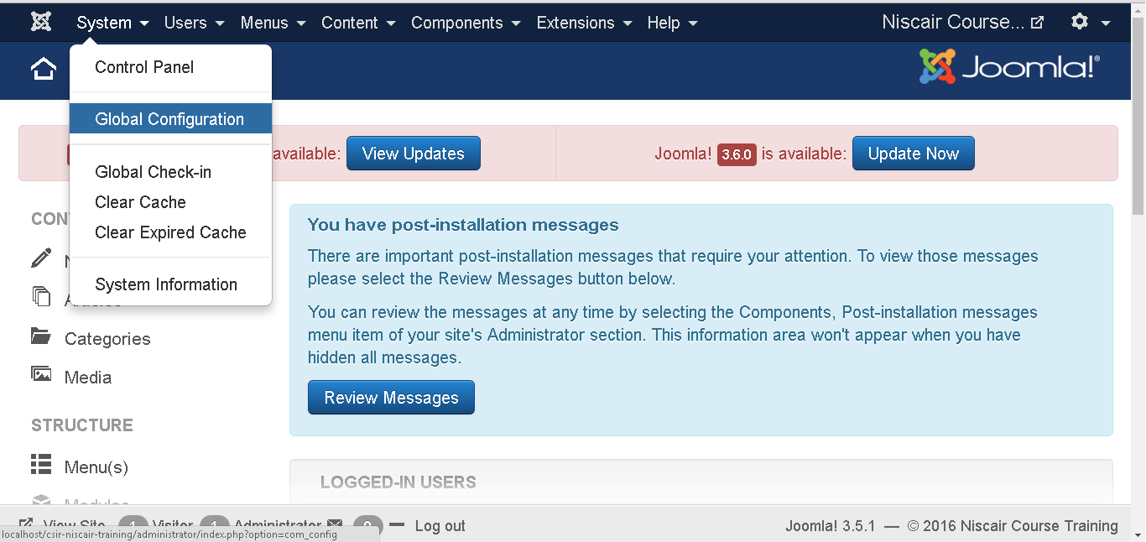
ADDING CONTACTS
Step (1): Go to System --> Global Configuration as shown in the following screen.

Slide 17
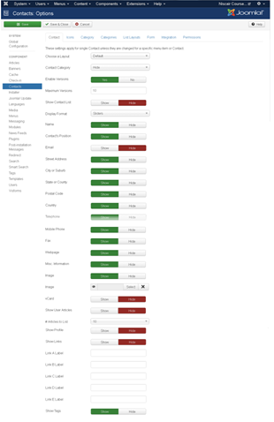
Next, click on Contacts in Joomla Global Configuration and you will get to see the following screen.

Slide 18
Below we have mentioned the details of the fields present on the Contact tab.
Choose a layout: It selects default layout for items.
Contact Category: In case of Hide, contact category will not display. In case of Show Without Link, it will display plain text and in case of Show With Link it will display as menu items.
Save History: It saves the version history of the component when selected as Yes. Otherwise no version history is saved.
Maximum Version: It always saves the maximum number of versions for an item.
Show Contact List: If Show is selected, the user can edit the contact information by selecting the drop-down menu list of all contact information.
Display Format: Display format for contacts.
Name: Name of contact is shown or hidden.
Contact's Position: The contact’s position is shown or hidden.
Email: The email address is shown or hidden.
Street Address: The street address is shown or hidden.
City or Suburb: The city or suburb is shown or hidden.
State or County: The state or county is shown or hidden.
Postal Code: The postal code is shown or hidden.

Slide 19
Country: The country is shown or hidden.
Telephone: The telephone number is shown or hidden.
Mobile Phone: The mobile phone number is shown or hidden.
Fax: The fax number is shown or hidden.
Web Page: The web page is shown or hidden.
Misc. Information: The Misc information is shown or hidden.
Image: The contact image is shown or hidden.
Image: Select the contact image from your local storage and click on Insert button to insert image.
vCard: The contact details in vCard format is shown or hidden.
Show User Articles: If Show is selected, it displays the list of articles created by the user.
Show Profile: If Show is selected, it displays the user profile.
Show Links: Show or Hide links.
Link A Label: An addition website links this contact.
Link B Label: An addition website links this contact.
Link C Label: An addition website links this contact.
Link D Label: An addition website links this contact.
Link E Label: An addition website links this contact.
Show Tags: The single category tags is shown or hidden.

Slide 20
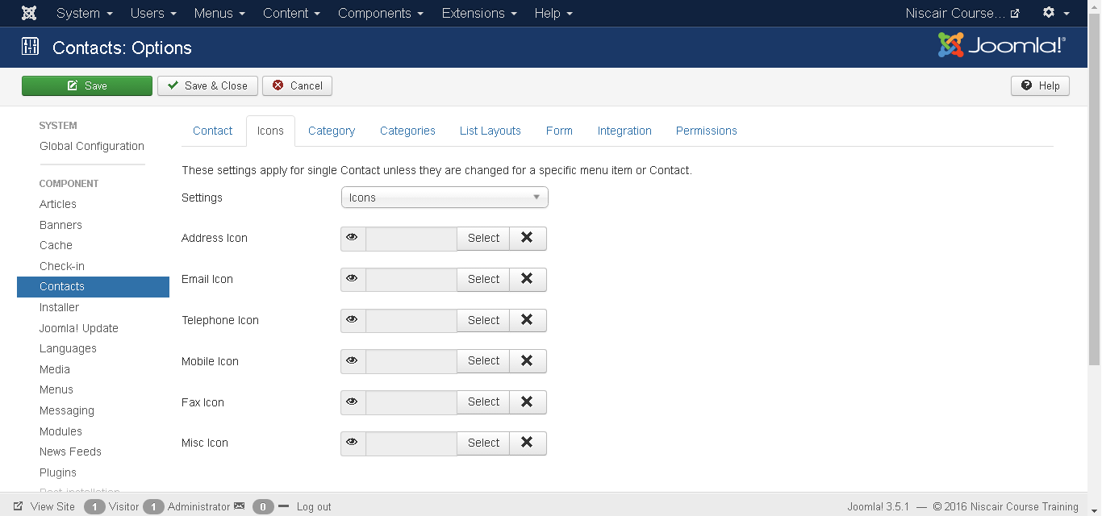
Step (2): In Icons tab, you can apply settings for single contact.

Slide 21
Below we have mentioned the details of the fields present in the Icons tab.
Settings: Displays icon, text or nothing beside the information.
Address Icon: Choose the address icon from the media folder by clicking on select button. Default icon gets displayed when nothing is selected.
Email Icon: Choose the email icon from the media folder by clicking on select button. Default icon gets displayed when nothing is selected.
Telephone Icon: Choose the telephone icon from the media folder by clicking on select button. Default icon gets displayed when nothing is selected.
Mobile Icon: Choose the mobile icon from the media folder by clicking on select button. Default icon gets displayed when nothing is selected.
Fax Icon: Choose the fax icon from the media folder by clicking on select button. Default icon gets displayed when nothing is selected.
Misc Icon: Choose the misc icon from the media folder by clicking on select button. Default icon gets displayed when nothing is selected.

Slide 22
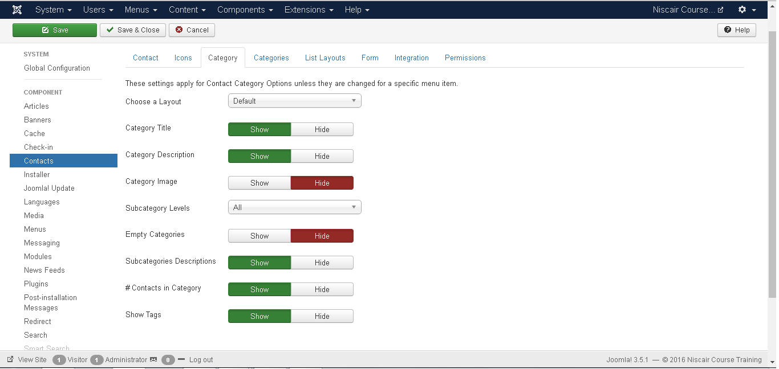
Step (3): In Category tab, you can apply settings for contact category options.

Slide 23
Below we have mentioned the details of the fields present in the Category tab.
Choose a Layout: Selects default layout.
Category Title: The category title is shown or hidden.
Category Description: The category description is shown or hidden.
Category Image: The category image is shown or hidden.
Subcategory Levels: Displays the levels of subcategory.
Empty Categories: The article which does not contain any categories are shown or hidden.
Subcategories Descriptions: The description of subcategories is shown or hidden.
Contacts in Category: The contacts present in category is shown or hidden.
Show Tags: The single category tags is shown or hidden.

Slide 24
Step (4): In Categories tab, you can apply settings for contact categories options.
Below we have mentioned the details of the fields present in the Categories tab.
Top Level Category Description: The description of top level category is shown or hidden.
Subcategory Levels: Display the levels of subcategory.
Empty Categories: The article which does not contain any categories are shown or hidden.
Subcategories Descriptions: The description of subcategories is shown or hidden.
Contacts in Category: The contacts present in category is shown or hidden.

Slide 25
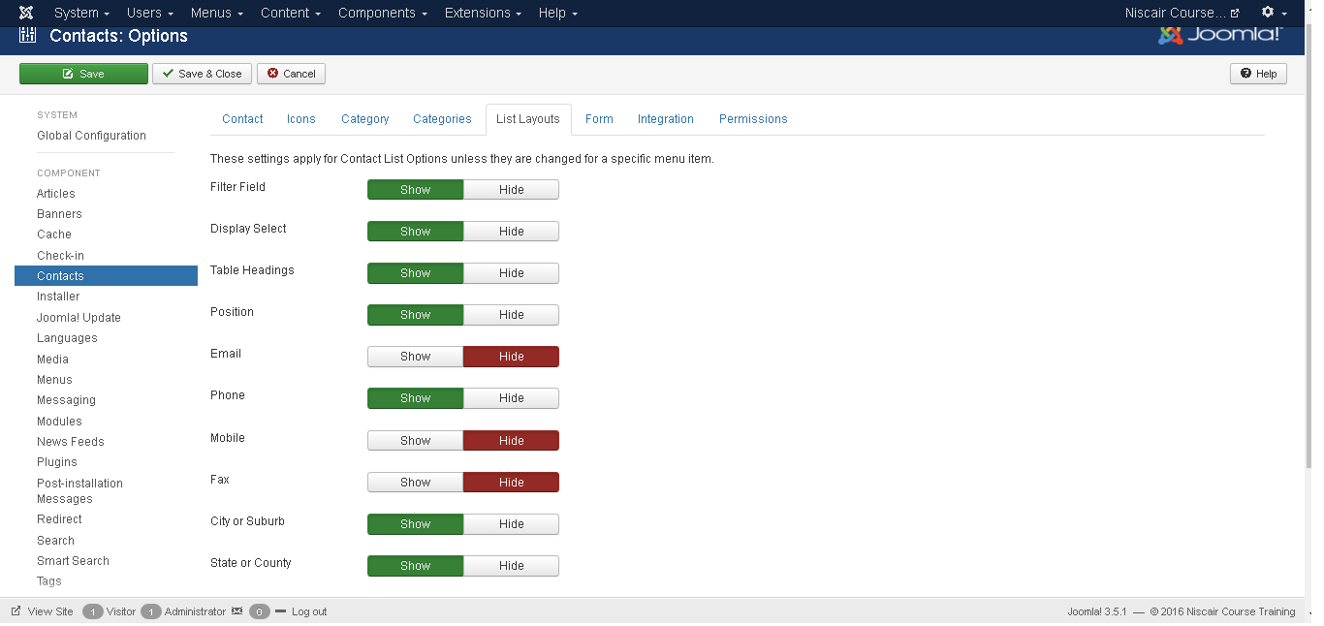
Step (5): In List Layouts tab, you can apply settings for contact list option.

Slide 26
Below we have mentioned the details of the fields present in the List Layout tab.
Filter Field: The filter field for the list is shown or hidden.
Display Select: Number of items selected is shown or hidden.
Table Headings: Heading present in the table is shown or hidden.
Position: In list of contacts, the column position is shown or hidden.
Email: In list of contacts, the column of email is shown or hidden.
Phone: In list of contacts, the column of phone is shown or hidden.
Mobile: In list of contacts, the column of mobile is shown or hidden.
Fax: In list of contacts, the column of fax is shown or hidden.
City or Suburb: In list of contacts, the column of city or suburb is shown or hidden.
State or County: In list of contacts, the column of state or county is shown or hidden.
Country: In list of contacts, the column of country is shown or hidden.
Pagination: Pagination is shown or hidden. The links of pages present at the bottom of the page helps the users to navigate to additional pages.
Pagination Results: The information of pagination result is shown or hidden.
Sort by: Contacts can be sorted in the form of name, order or sort name.

Slide 27
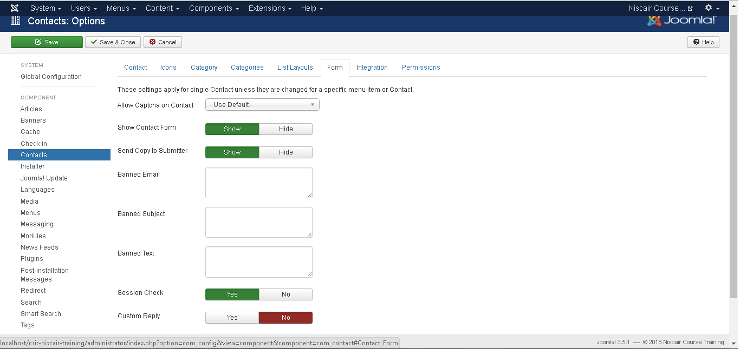
Step (6): In Form tab, you can apply setting for single contact.
Allow Captcha on Contact: In contact form, the captcha plugin is selected.
Show Contact Form: Contact form is shown or hidden.
Send Copy to Submitter: It allows email copy to be sent to submitter.
Banned Email: In contact form, email address is not allowed to submit.
Banned Subject: In contact form, no subject is allowed to submit.
Banned Text: In contact form, text is not allowed to submit in the body.
Session Check: The existing session cookies are checked.
Custom Reply: The plugins are allowed to handle the integration with other system by turning off the automated reply.
Contact Redirect: After user has sent the mail, an alternative URL is redirected.

Slide 28
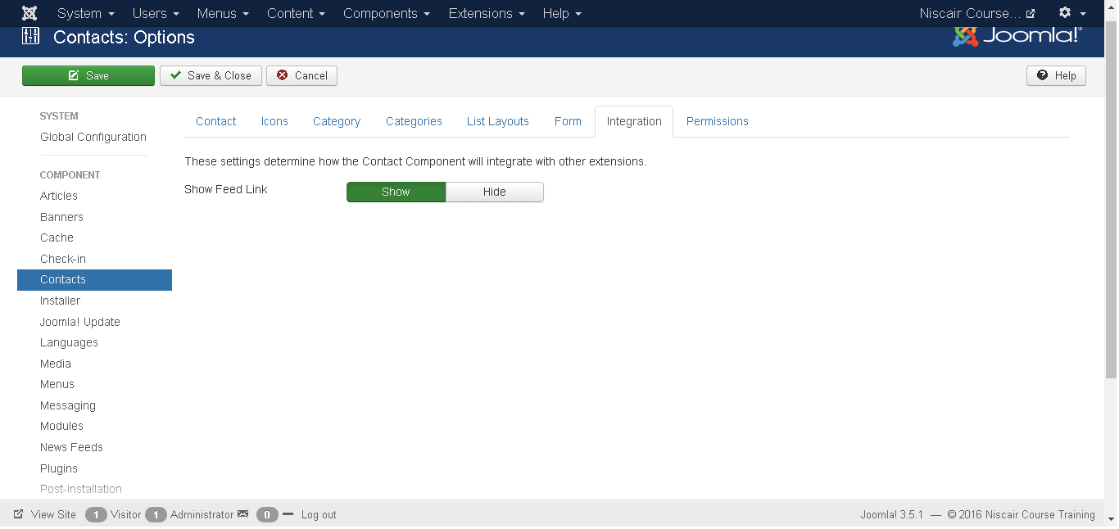
Step (7): In Integration tab, as seen in the figure below:
Show Feed Link: URL of feed links is shown or hidden.

Slide 29
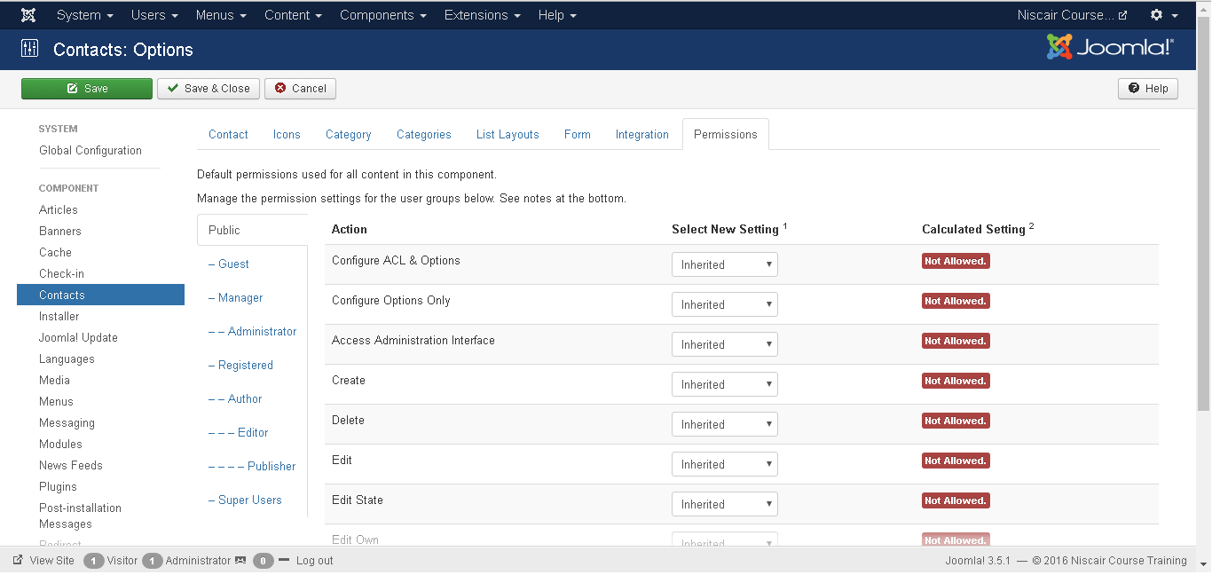
Step (8): In Permissions tab, we can view the six actions as displayed in the screen below. The Permission tab is used to manage the permission settings for the user groups.

Slide 30
Configure: It allows users to edit the user option.
Access Administration Interface: It allows users to access the administration interface.
Create: It allows users in group to create the content present in the extension.
Delete: It allows users in group to delete the content present in the extension.
Edit: It allows users in group to edit the content present in the extension.
Edit State: It allows users in group to change the state of content present in the extension.
Edit Own: It allows users in group to edit any content they submitted in the extension.
Toolbar
Following are the toolbar options in the contacts.
Save: Saves your contact setting.
Save & Close: Saves the contact setting and closes the current screen.
Cancel: Cancels the contact setting in Joomla.

Slide 31
ADDING NEWS FEED
Step (1): Go to System --> Global Configuration as shown in the following screen.

Slide 32
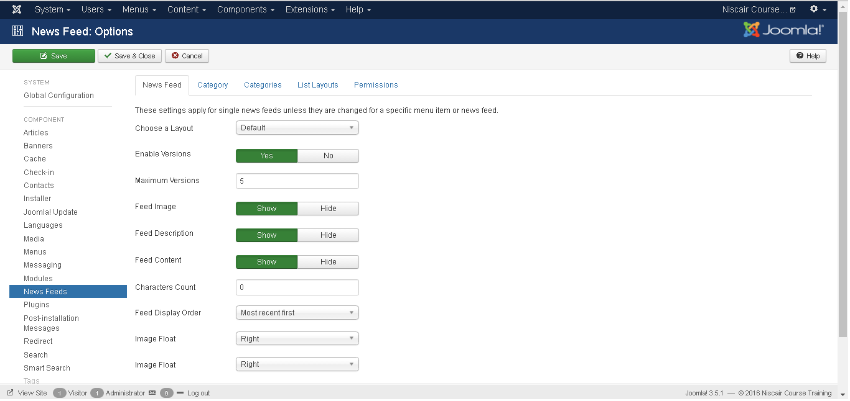
Next, click on Newsfeeds option in Joomla Global Configuration. You will get the screen below and then select appropriate values.

Slide 33
Below we have mentioned the details of the fields present in Joomla adding news feed page.
Choose a Layout: It is default layout for items.
Save History: It saves the version history of the component when selected as Yes. Otherwise no version history is saved.
Maximum Version: It always saves the maximum number of versions for an item.
Feed Image: The Feed image is shown or hidden.
Feed Description: The Feed description is shown or hidden.
Feed Content: The content of feed is shown or hidden.
Characters Count: Displays number of characters per feed.
Feed Display Order: Displays the feed in order.
Image Float: Controls the position of the images.
Show Tags: The single category tags are shown or hidden.

Slide 34
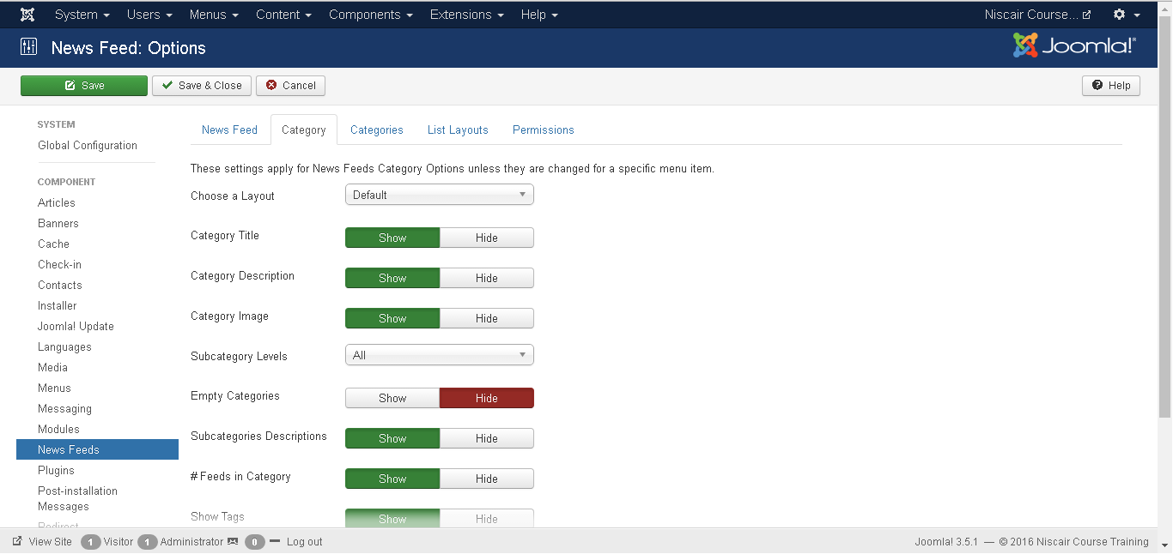
Step (2): In Category tab, you can apply settings for contact category options.

Slide 35
Below we have mentioned the details of the fields present in the Category tab.
Choose a Layout: Selects default layout.
Category Title: The category title is shown or hidden.
Category Description: The category description is shown or hidden.
Category Image: The category image is shown or hidden.
Subcategory Levels: Display the levels of subcategory.
Empty Categories: The article which does not contain any categories are shown or hidden.
Subcategories Descriptions: The description of subcategories is shown or hidden.
#Feeds in Category: The feeds present in category is shown or hidden.
Show Tags: The single category tags are shown or hidden.

Slide 36
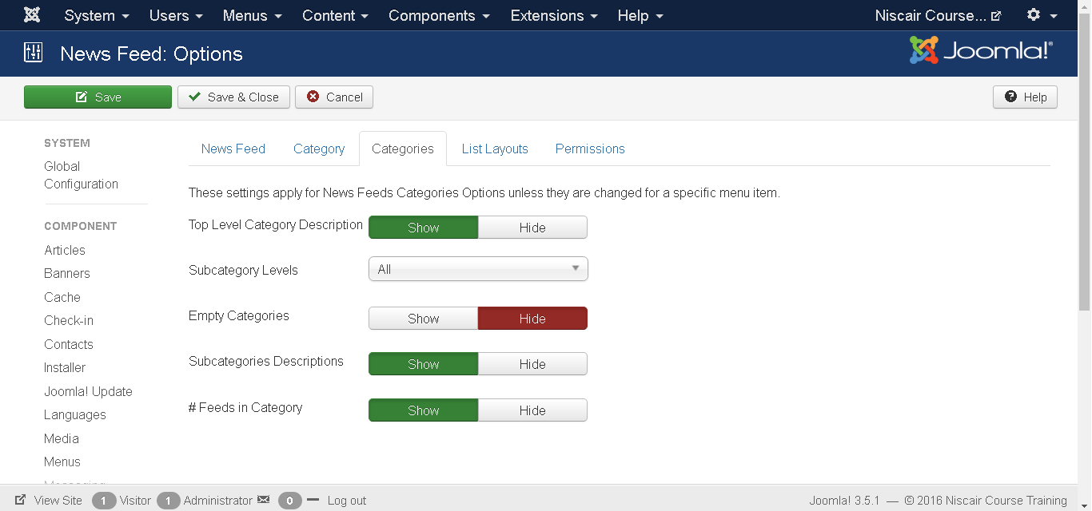
Step (3): In Categories tab, you can apply settings for contact categories options.
Below we have mentioned the details of the fields present in the Categories tab.
Top Level Category Description: The description of top level category is shown or hidden.
Subcategory Levels: Displays the levels of subcategory.
Empty Categories: The article which does not contain any categories are shown or hidden.
Subcategories Descriptions: The Description of subcategories are shown or hidden.
#Feeds in Category: The feeds present in category is shown or hidden.

Slide 37
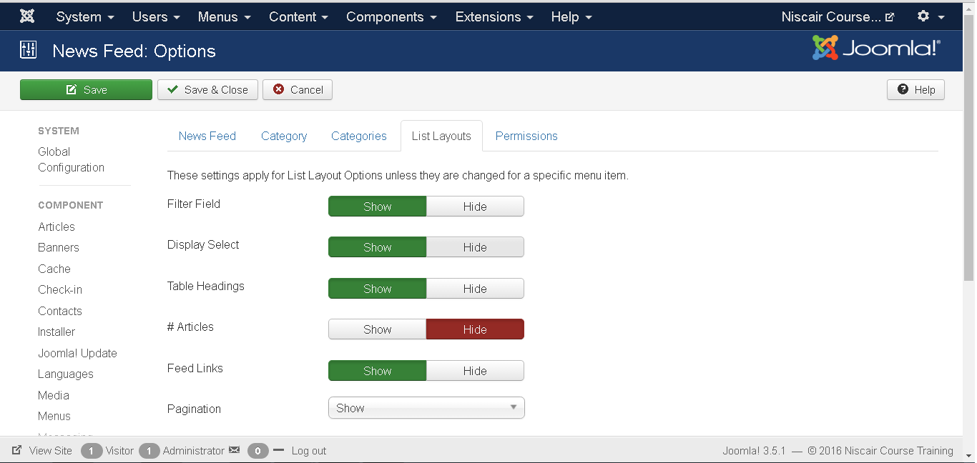
Step (4): In List Layouts tab, you can apply settings for contact list option.

Slide 38
Below we have mentioned the details of the fields present in the List Layout tab.
Filter Field: The filter field for the list is shown or hidden.
Display Select: Number of items selected is shown or hidden.
Table Headings: Heading present in the table is shown or hidden.
# Articles: Articles present in feed is shown or hidden.
Feed Links: URL of feed links is shown or hidden.
Pagination: Pagination is shown or hidden. The links of pages present at the bottom of the page helps the users to navigate to additional pages.
Pagination Results: The information of pagination result is shown or hidden.

Slide 39
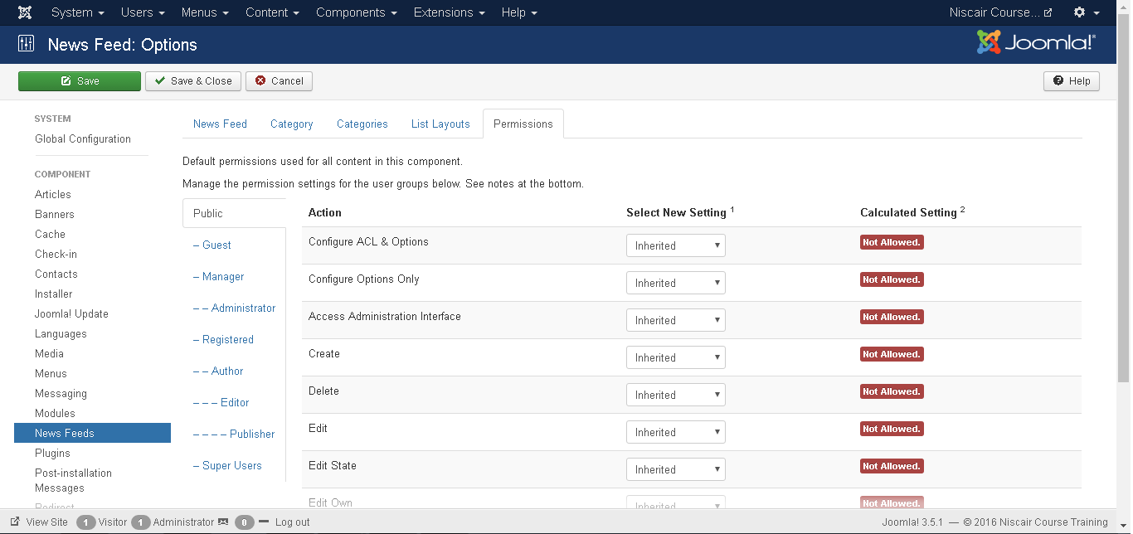
Step (5): In Permissions tab, we can view the actions as displayed in the screen below. The Permission tab is used to manage the permission settings for the user groups.

Slide 40
Configure: It allows users to edit the user option.
Access Administration Interface: It allows users to access the administration interface.
Create: It allows users in a group to create the content present in the extension.
Delete: It allows users in a group to delete the content present in the extension.
Edit: It allows users in a group to edit the content present in the extension.
Edit State: It allows users in a group to change the state of content present in the extension.
Edit Own: It allows users in a group to edit any content they submitted in the extension.
Toolbar
Following are the toolbar options in the Newsfeeds.
Save: Saves your news feed setting.
Save & Close: Saves the news feed setting and closes the current screen.
Cancel: Cancels the news feed setting in Joomla.

Slide 41
Thank You

