Slide 1
CONTENT MANAGEMENT SYSTEM
Presented by:
Mukesh A. Pund
Sr. Principal Scientist
CSIR-NISCAIR, New Delhi

Slide 2
JOOMLA
ADDING TEMPLATES & TEMPLATE CUSTOMIZATION

Slide 3
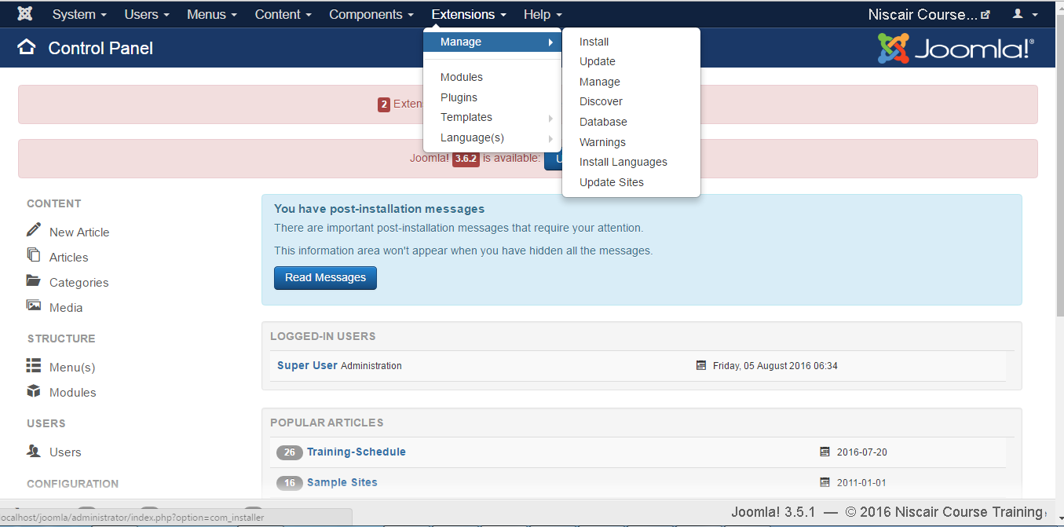
ADDING TEMPLATE
Step (1): Click on Extensions → Manage → Install as shown below.

Slide 4
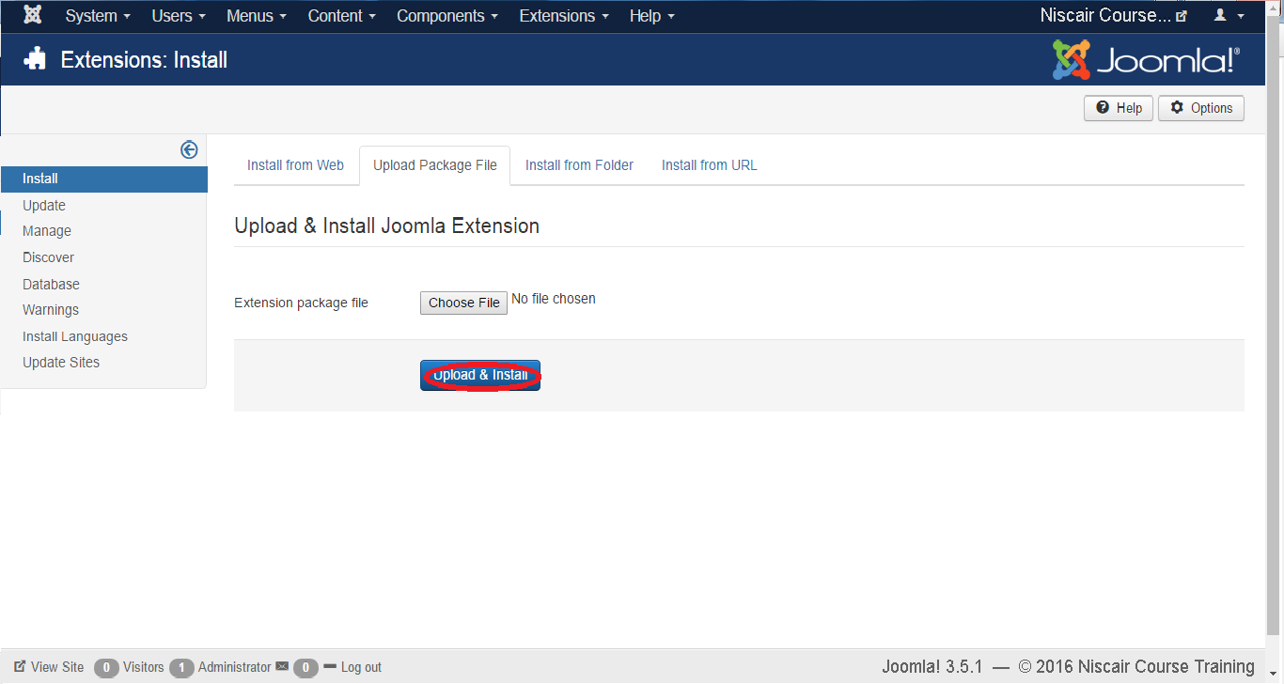
Step (2): After clicking on Extension, you will get the following screen. Here you can Upload / Install the template file either from the Web, Package, Directory or URL. Choose the template file which is available on your system and later click on the Upload & Install button.

Slide 6
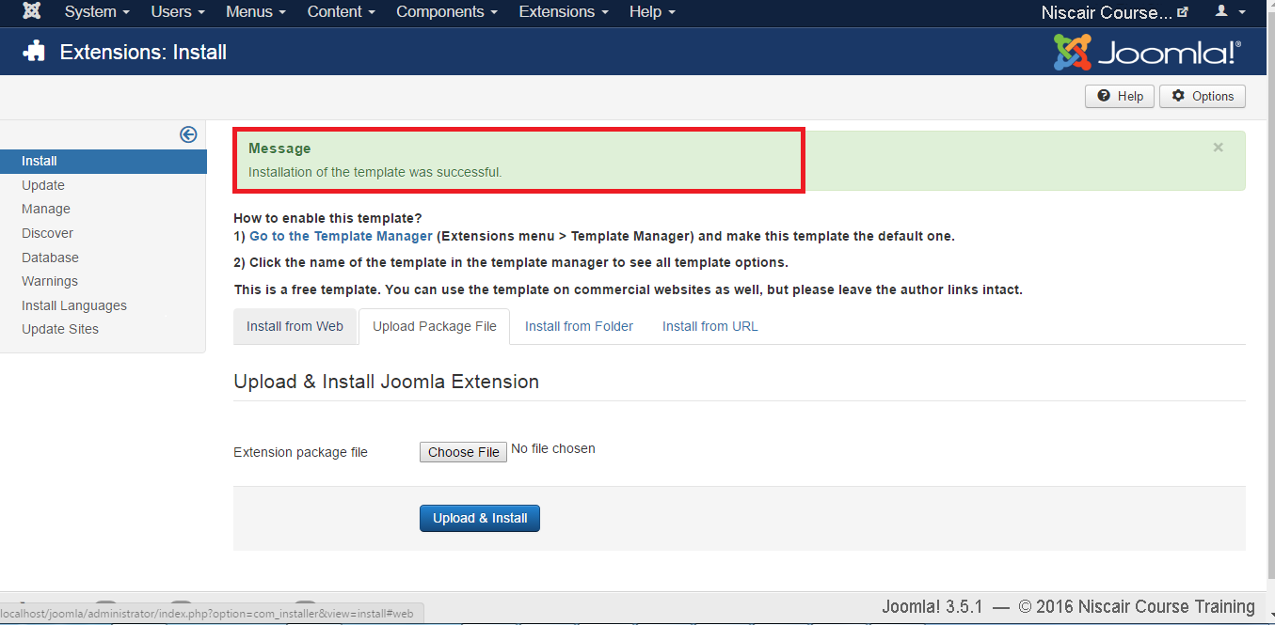
Step(3): After click Upload & Install button you will get the following screen

Slide 7
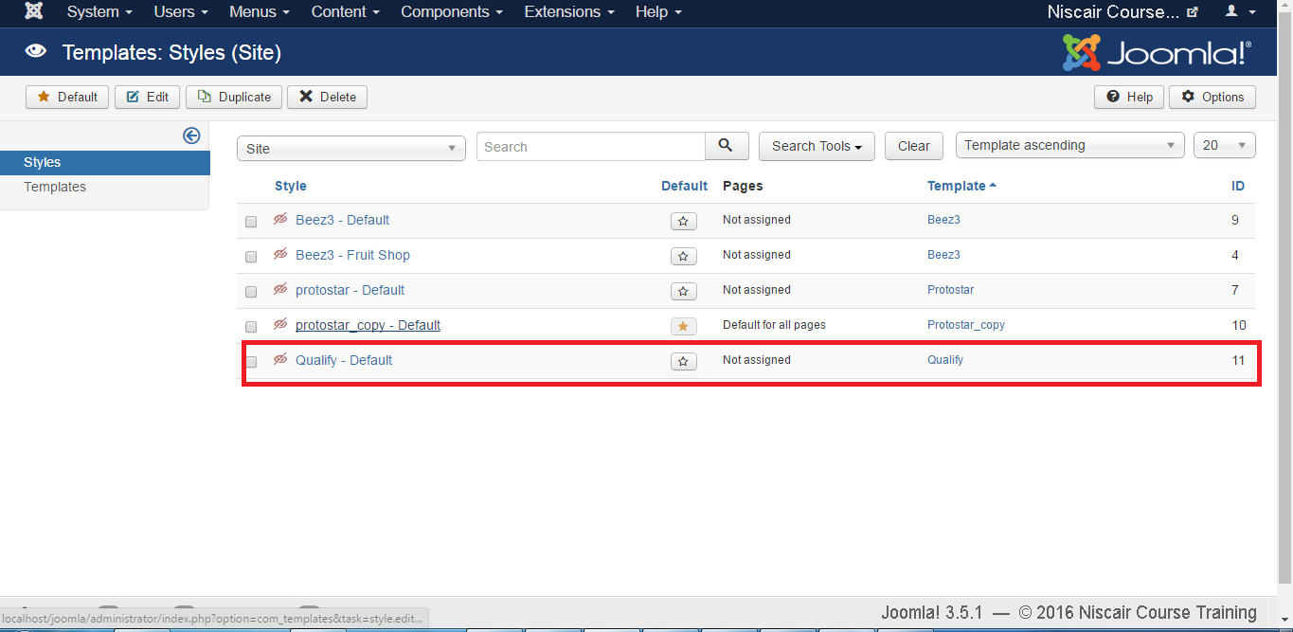
Step (4): After installing the template successfully, you can go to the template Extensions → Templates
see the new installed template present in the list as shown below.
Toolbar
Following are the options on the toolbar of the Adding Template screen:
Default: Select the default template.
Edit: Select the template for editing.
Duplicate: Duplicate the copy of the selected template.
Delete: Delete the template from Joomla site.

Slide 8
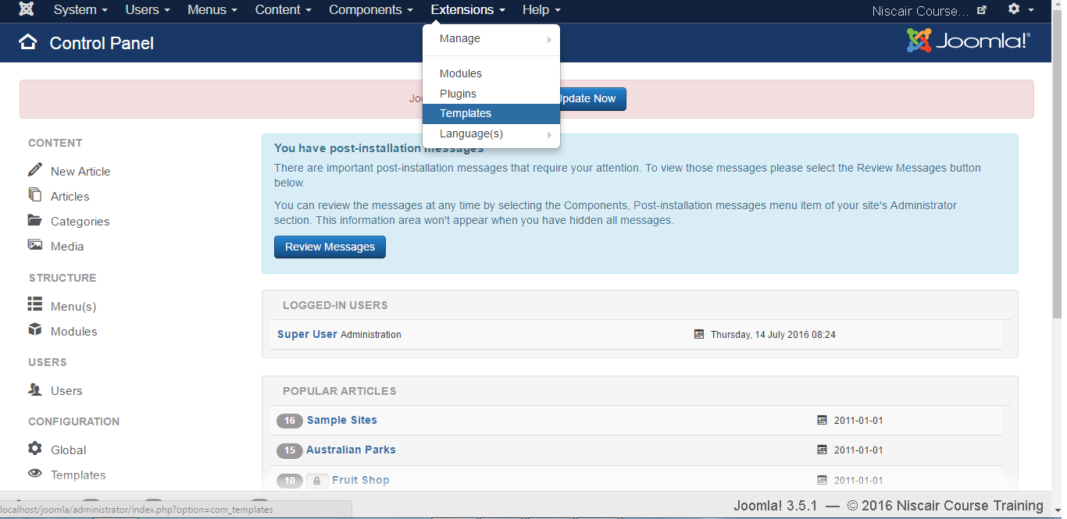
TEMPLATE CUSTOMIZATION
Step (1): Click Extensions --> Template as shown below.

Slide 9
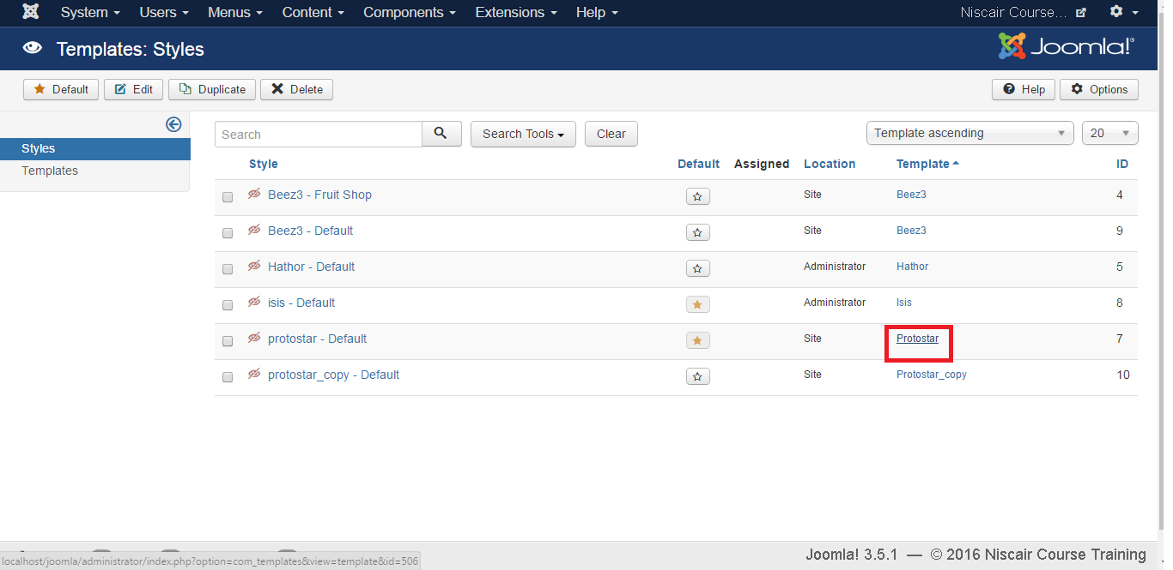
Step (2): Template : Styles page get displayed as shown below. Here, you can click directly on any of the templates listed in Template column.

Slide 10
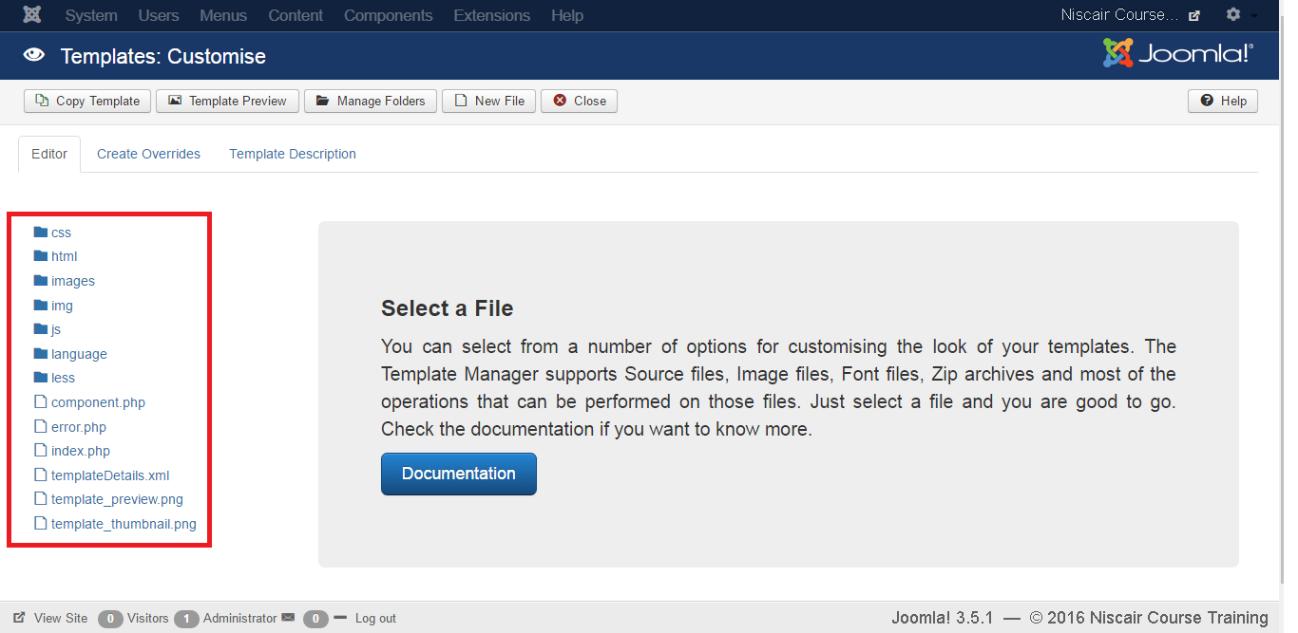
Step (3): After clicking on any one of the above templates you will get the screen as shown below. In the Editor tab, template files are listed on the left side of the page as seen in the screenshot below:

Slide 11
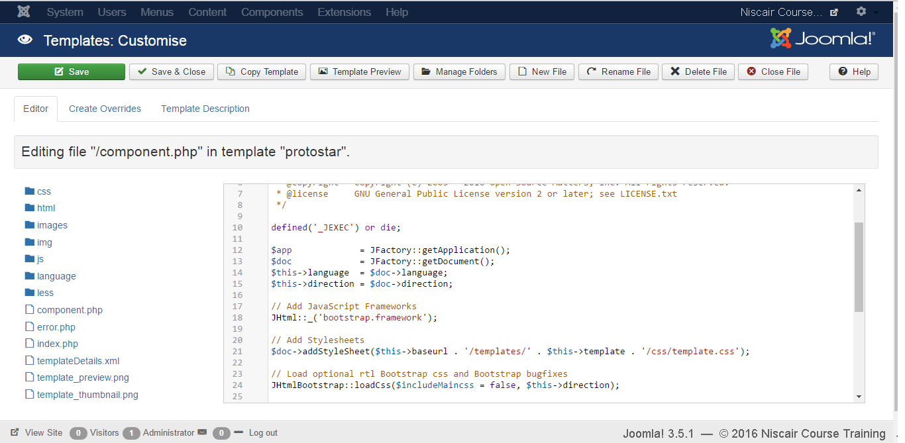
Step (4): Select any of the files by clicking on it for editing.

Slide 12
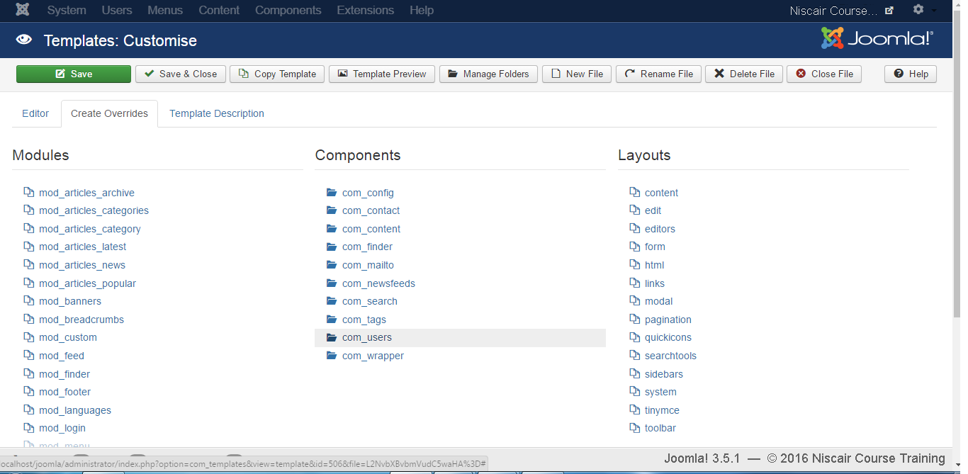
Step (5): Click on Create Overrides tab, you will see the list of Modules, Components, and Layouts present in the template as shown below. Here you can easily override the new templates.

Slide 13
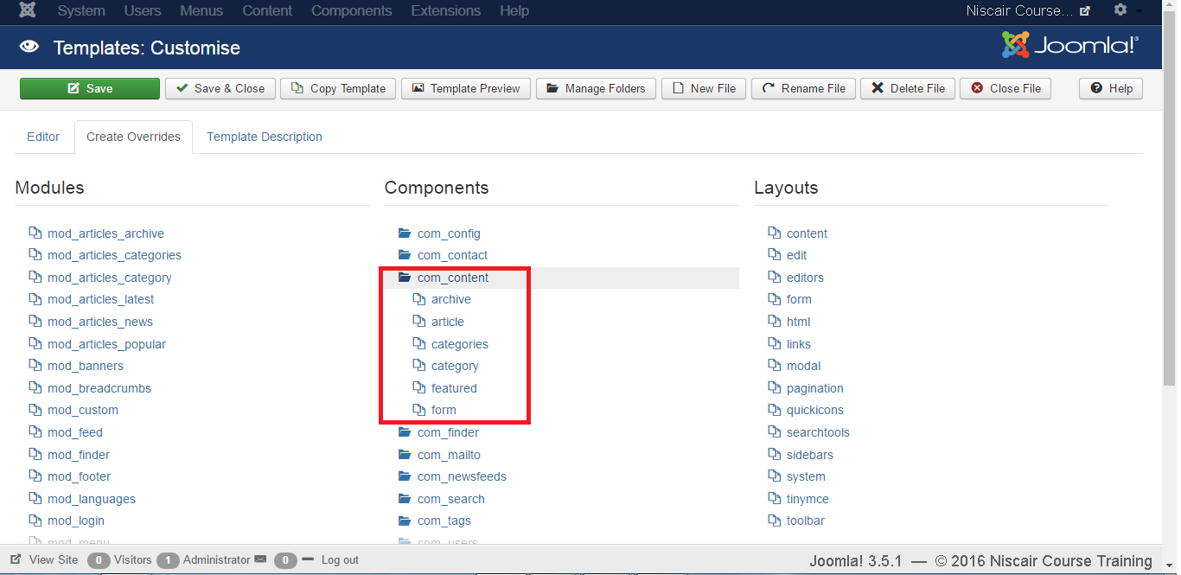
Step (6): Click on any one component and you will see many sub components present inside it as shown below.

Slide 14
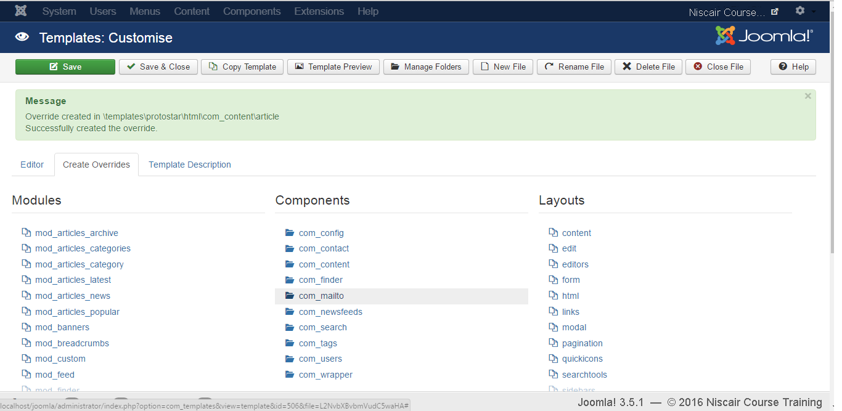
Step (7): When you click on any one sub component then you will get the following message.

Slide 15
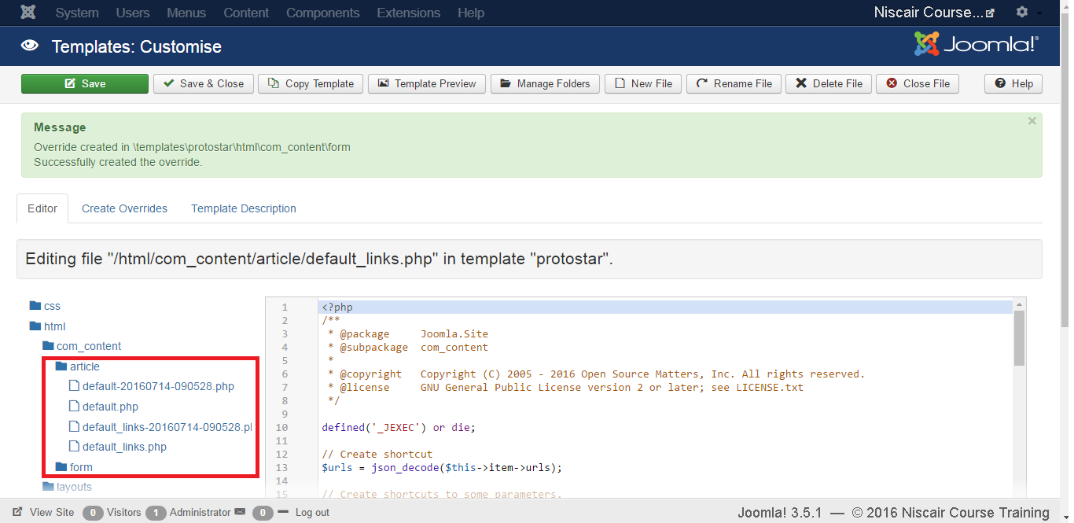
Step (8): You can go back to Editor tab to check if override file is available for editing or not as shown below.

Slide 16
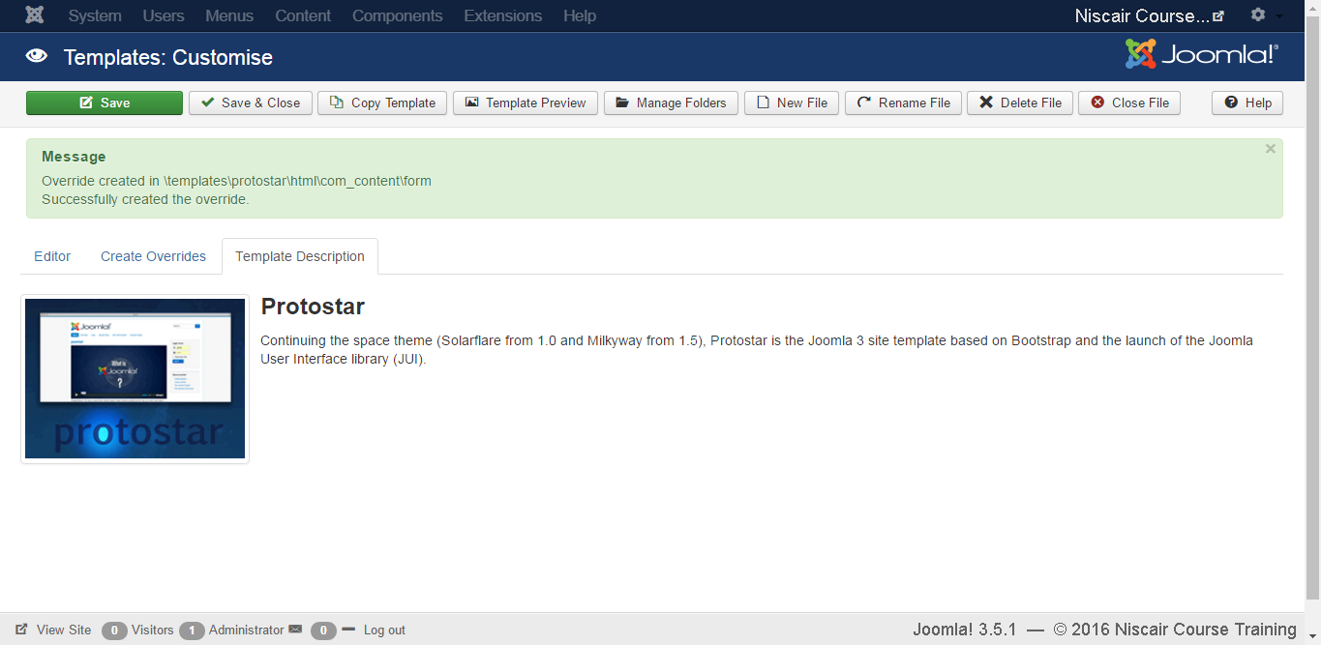
Step (9): Click on Template Description tab, you will see the detailed description of the selected template as shown below.

Slide 17
Toolbar
Following are the toolbar options in the Template .
Save: Saves your template .
Save & Close: Saves the templates and closes the current screen.
Copy Template: Enter the template name and click on Copy Template button. This will copy the template.

Slide 18
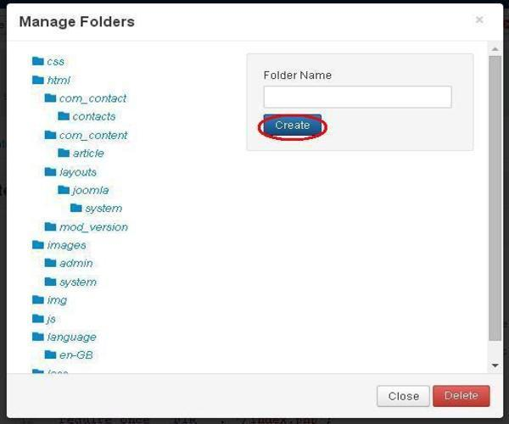
Manage Folders: It creates a new folder inside the template. Enter the folder name in the field and click on Create button.

Slide 19
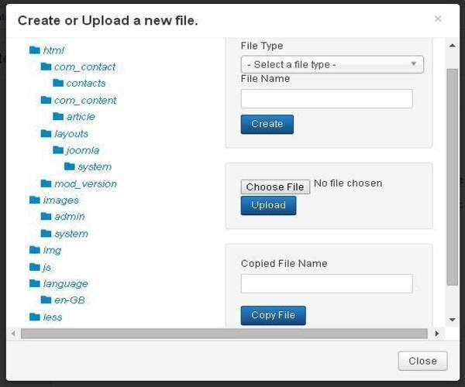
New File: You can select the file type by clicking on the dropdown of File Type and enter the name of the file and click on Create button. This will create a new file. The second block is used to upload a file directly from your system and the last block is used to copy the file.

Slide 20
Rename File: Enter the new name for the file and click on Rename button.
Delete File: Deletes the particular file.
Close File: Closes the current file.

Slide 21
Thank You

